Slide 1
Timing Variation
2/6/2024

Slide 2
GOAL
We need to investigate the effects of timing between our oscillatory inhibitory gamma rhythm and our excitatory inputs. We will take a look at the voltage traces, conductance traces, activation times, and the corresponding dendritic I/O curves that arise as a result.

Slide 3
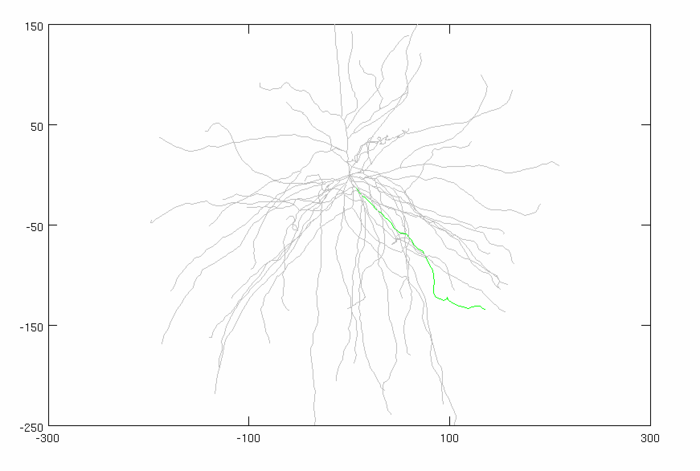
Model Parameters
Inhibitory Gamma
N_syn = 30 (ON SOMA)
Firing rate: 50 Hz
Distribution: 3 ms
Conductance: 0.005
Adjusted Current
Amplitude: 1.875
Noise: 0 nA
Stimulus
Total synapses: 40 synapses
AMPA: 0.0015 µS
NMDA: 0.0039 µS
Firing rate: 50 Hz
Start Time: VARIABLE
Noise: 0 ms
Location: 50% of DEND
(FOCAL, SYNCHED)
AVG: 25 trials
CONSTANT

Slide 4
Medium Conductance Conditions
g_{GABAa}: 0.005 µS

Slide 5
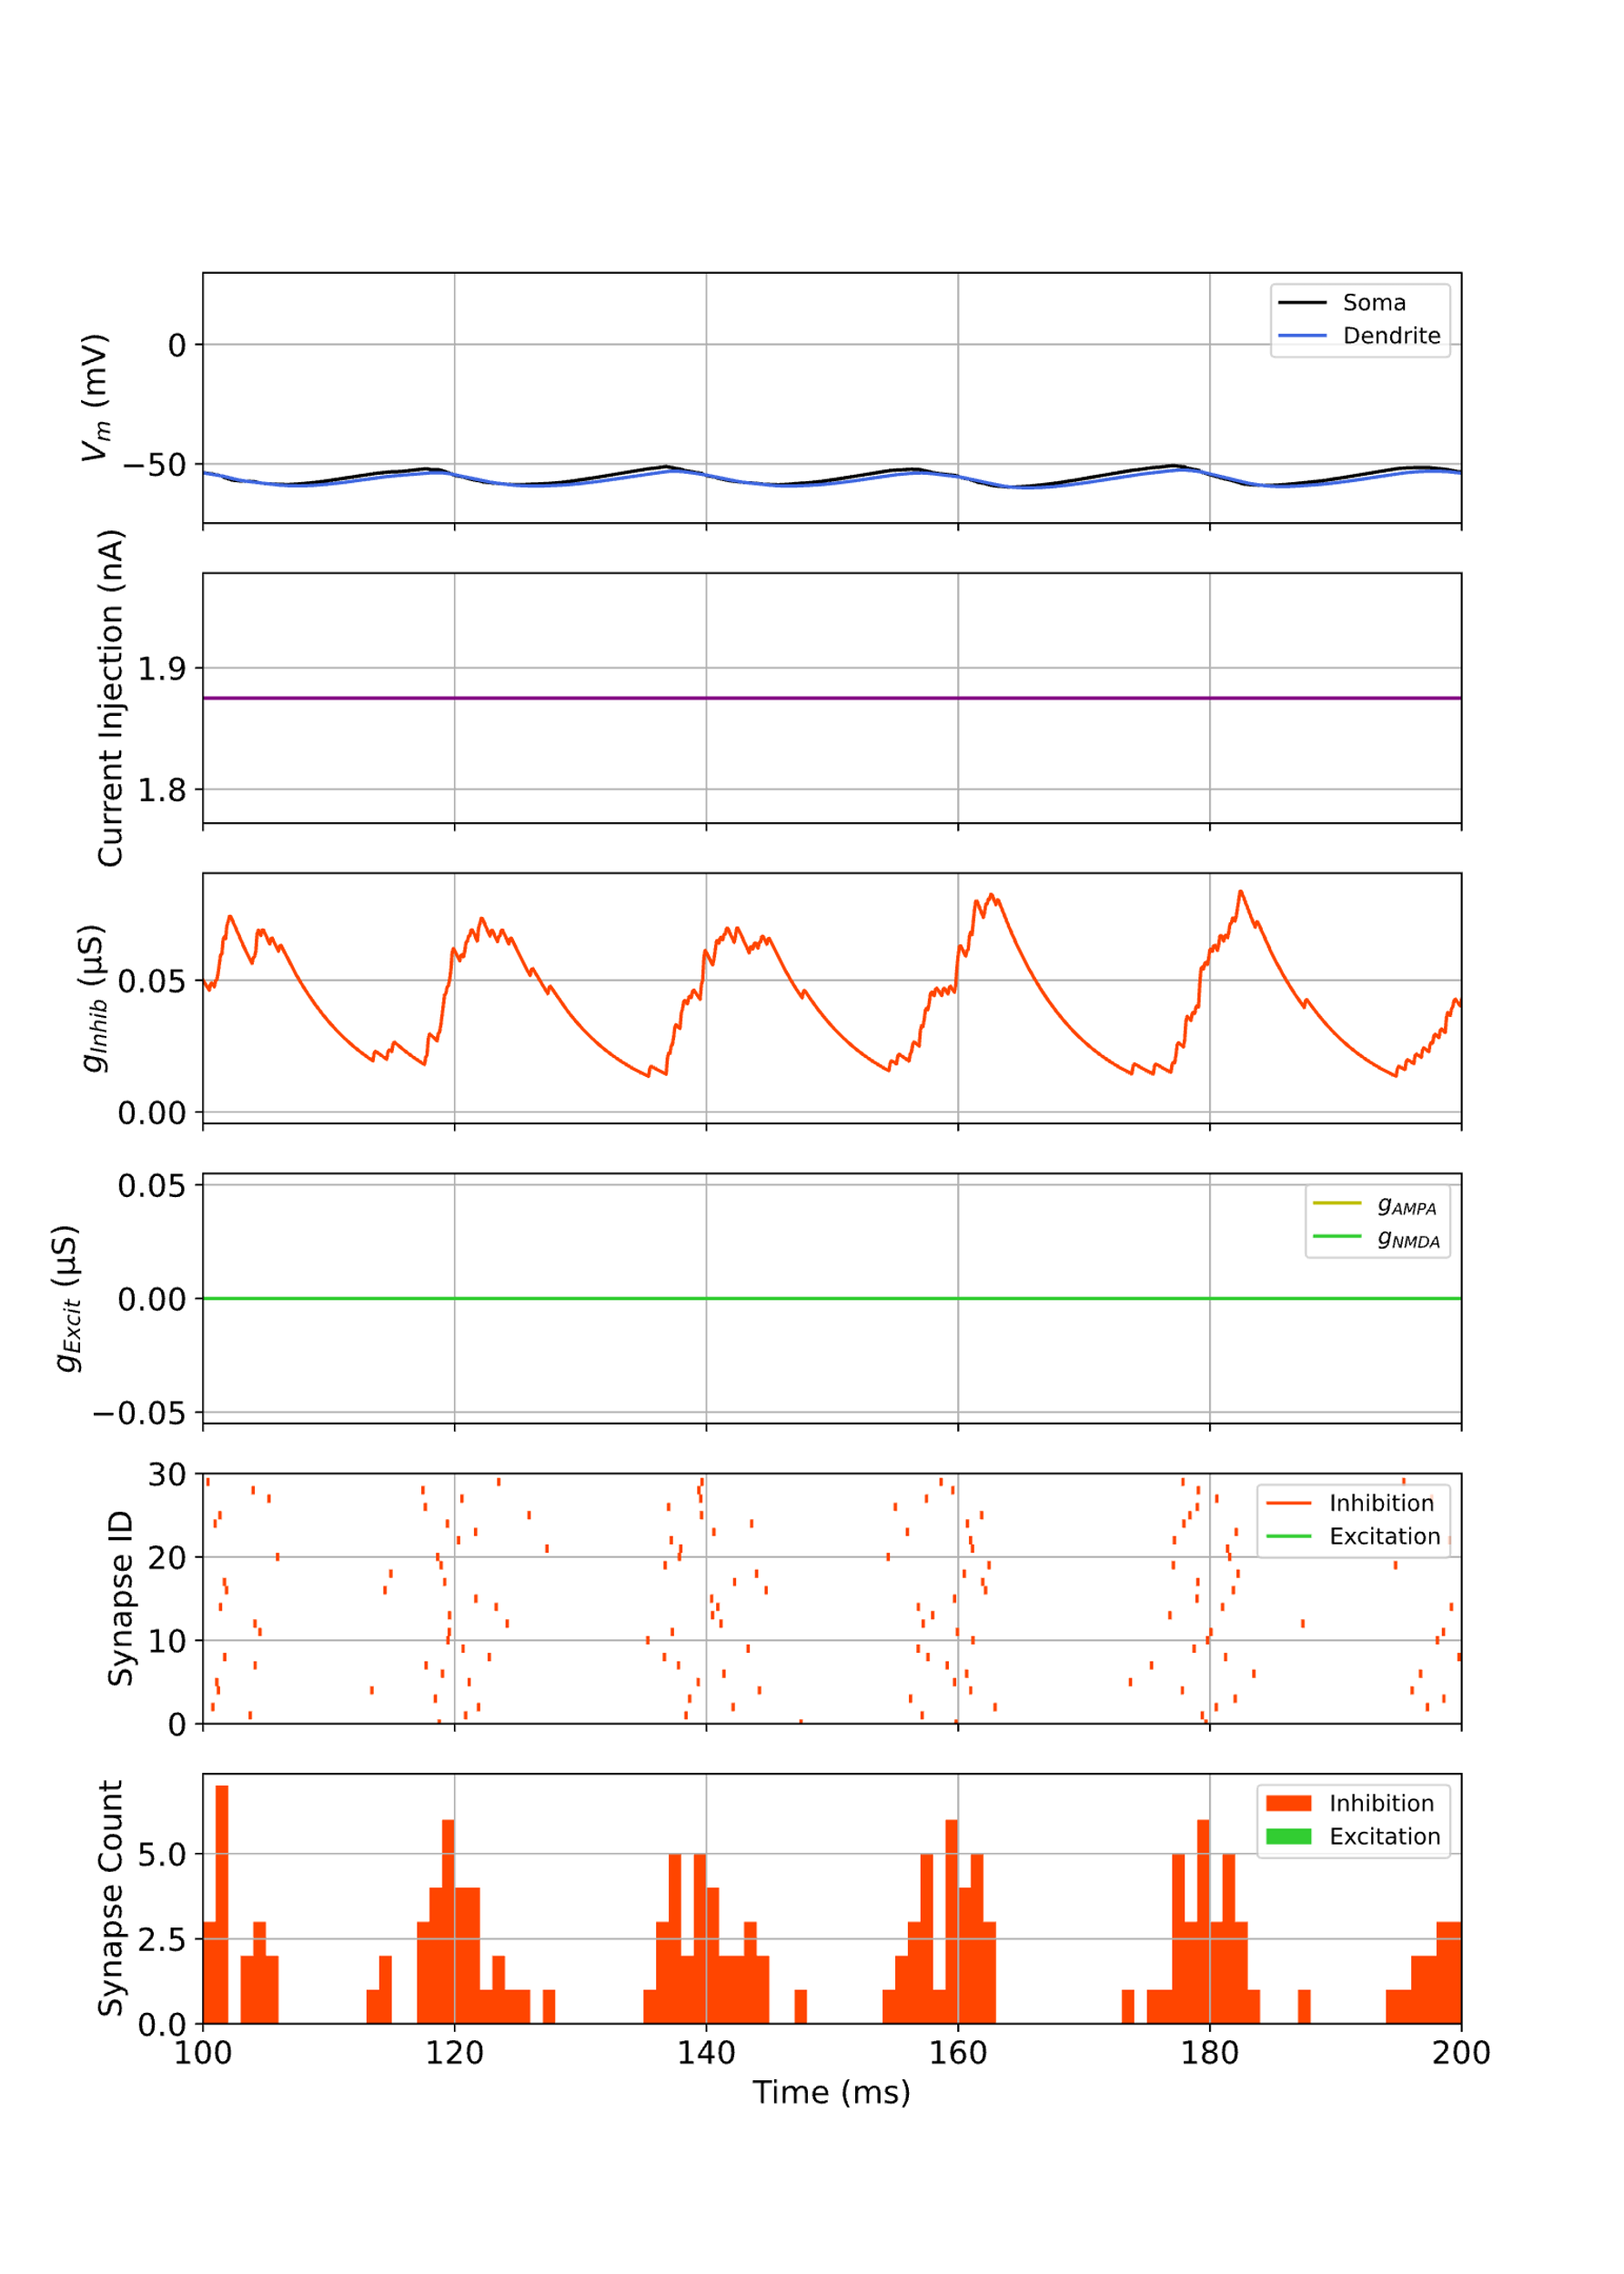
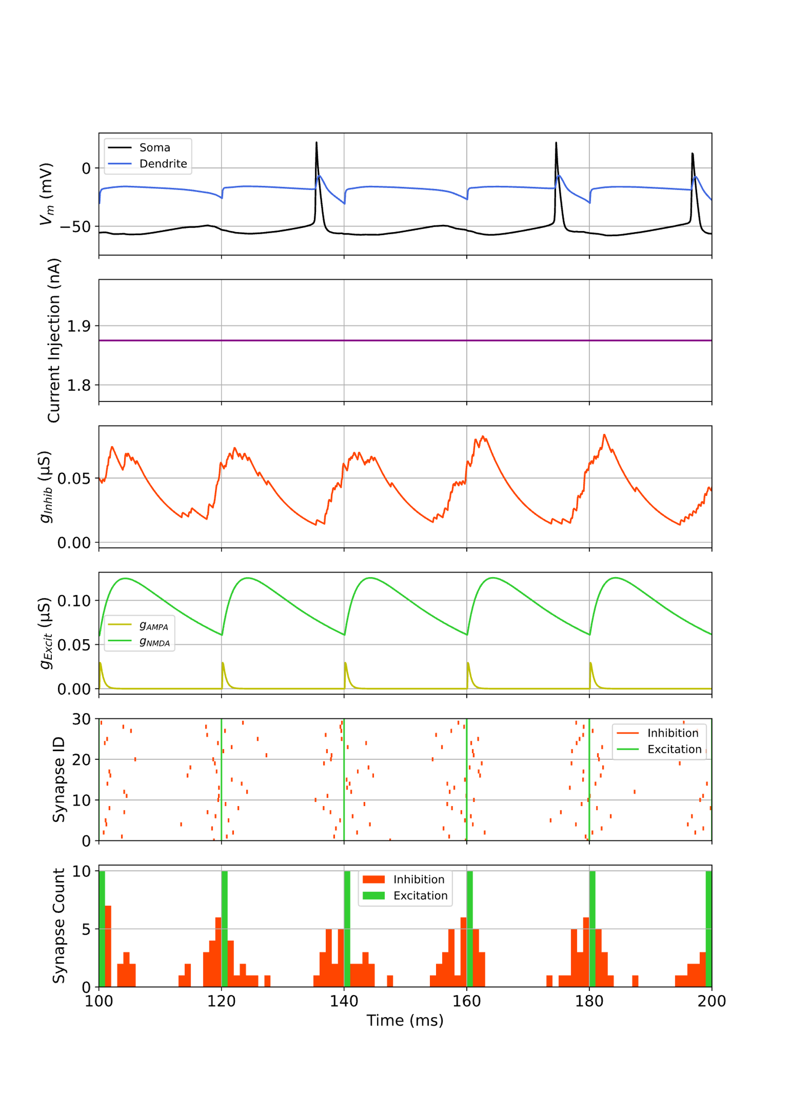
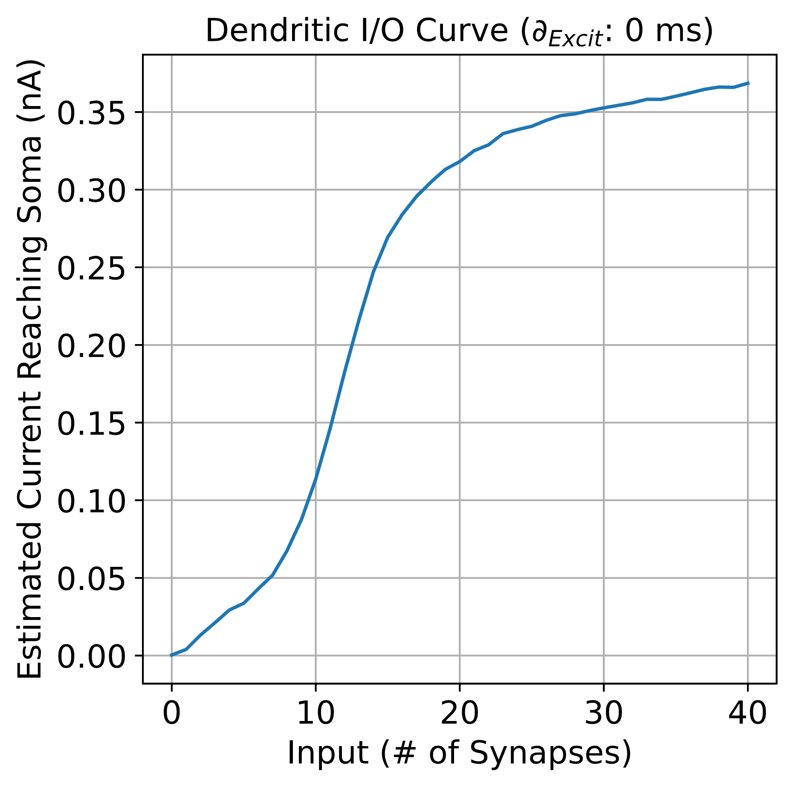
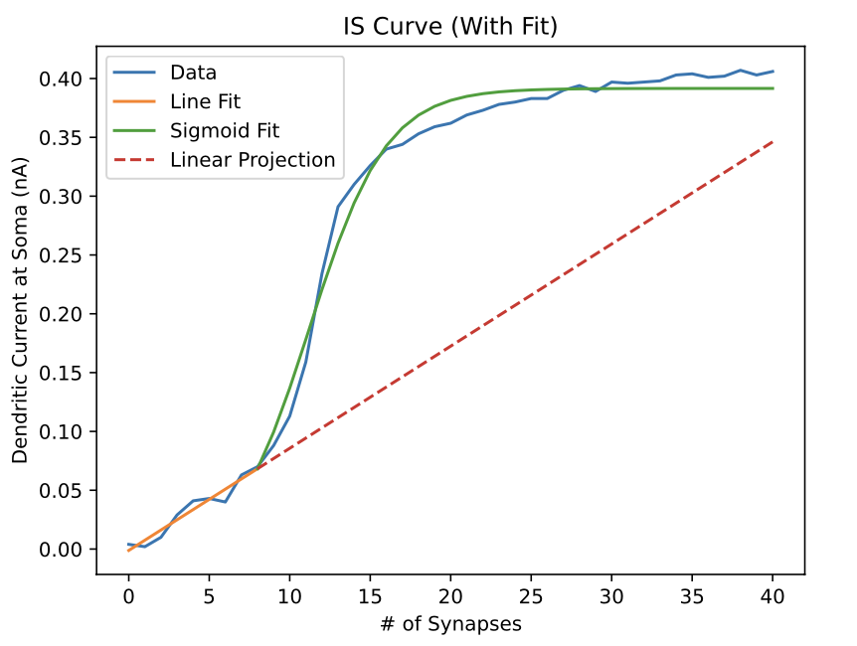
CASE #1: Time Offset: 0 ms
N_{Syn}: 0
N_{Syn}: 20

Slide 6
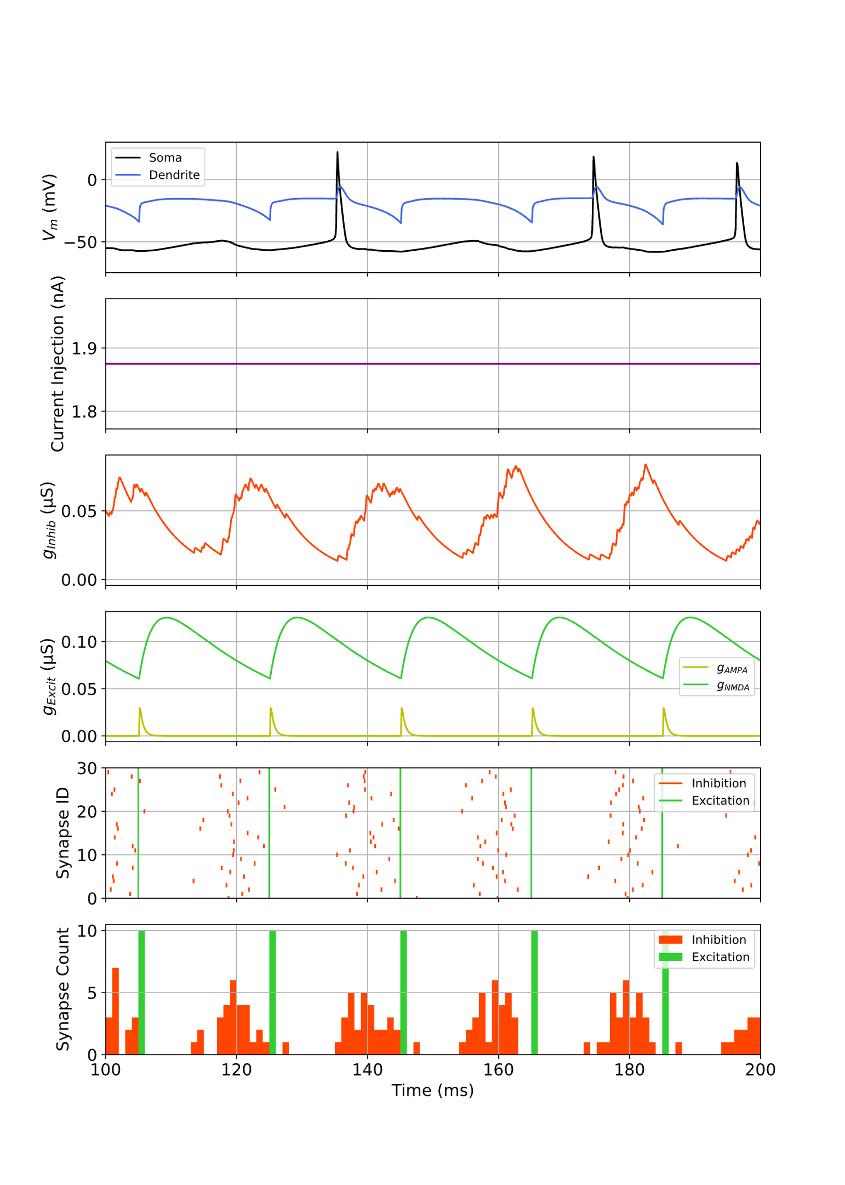
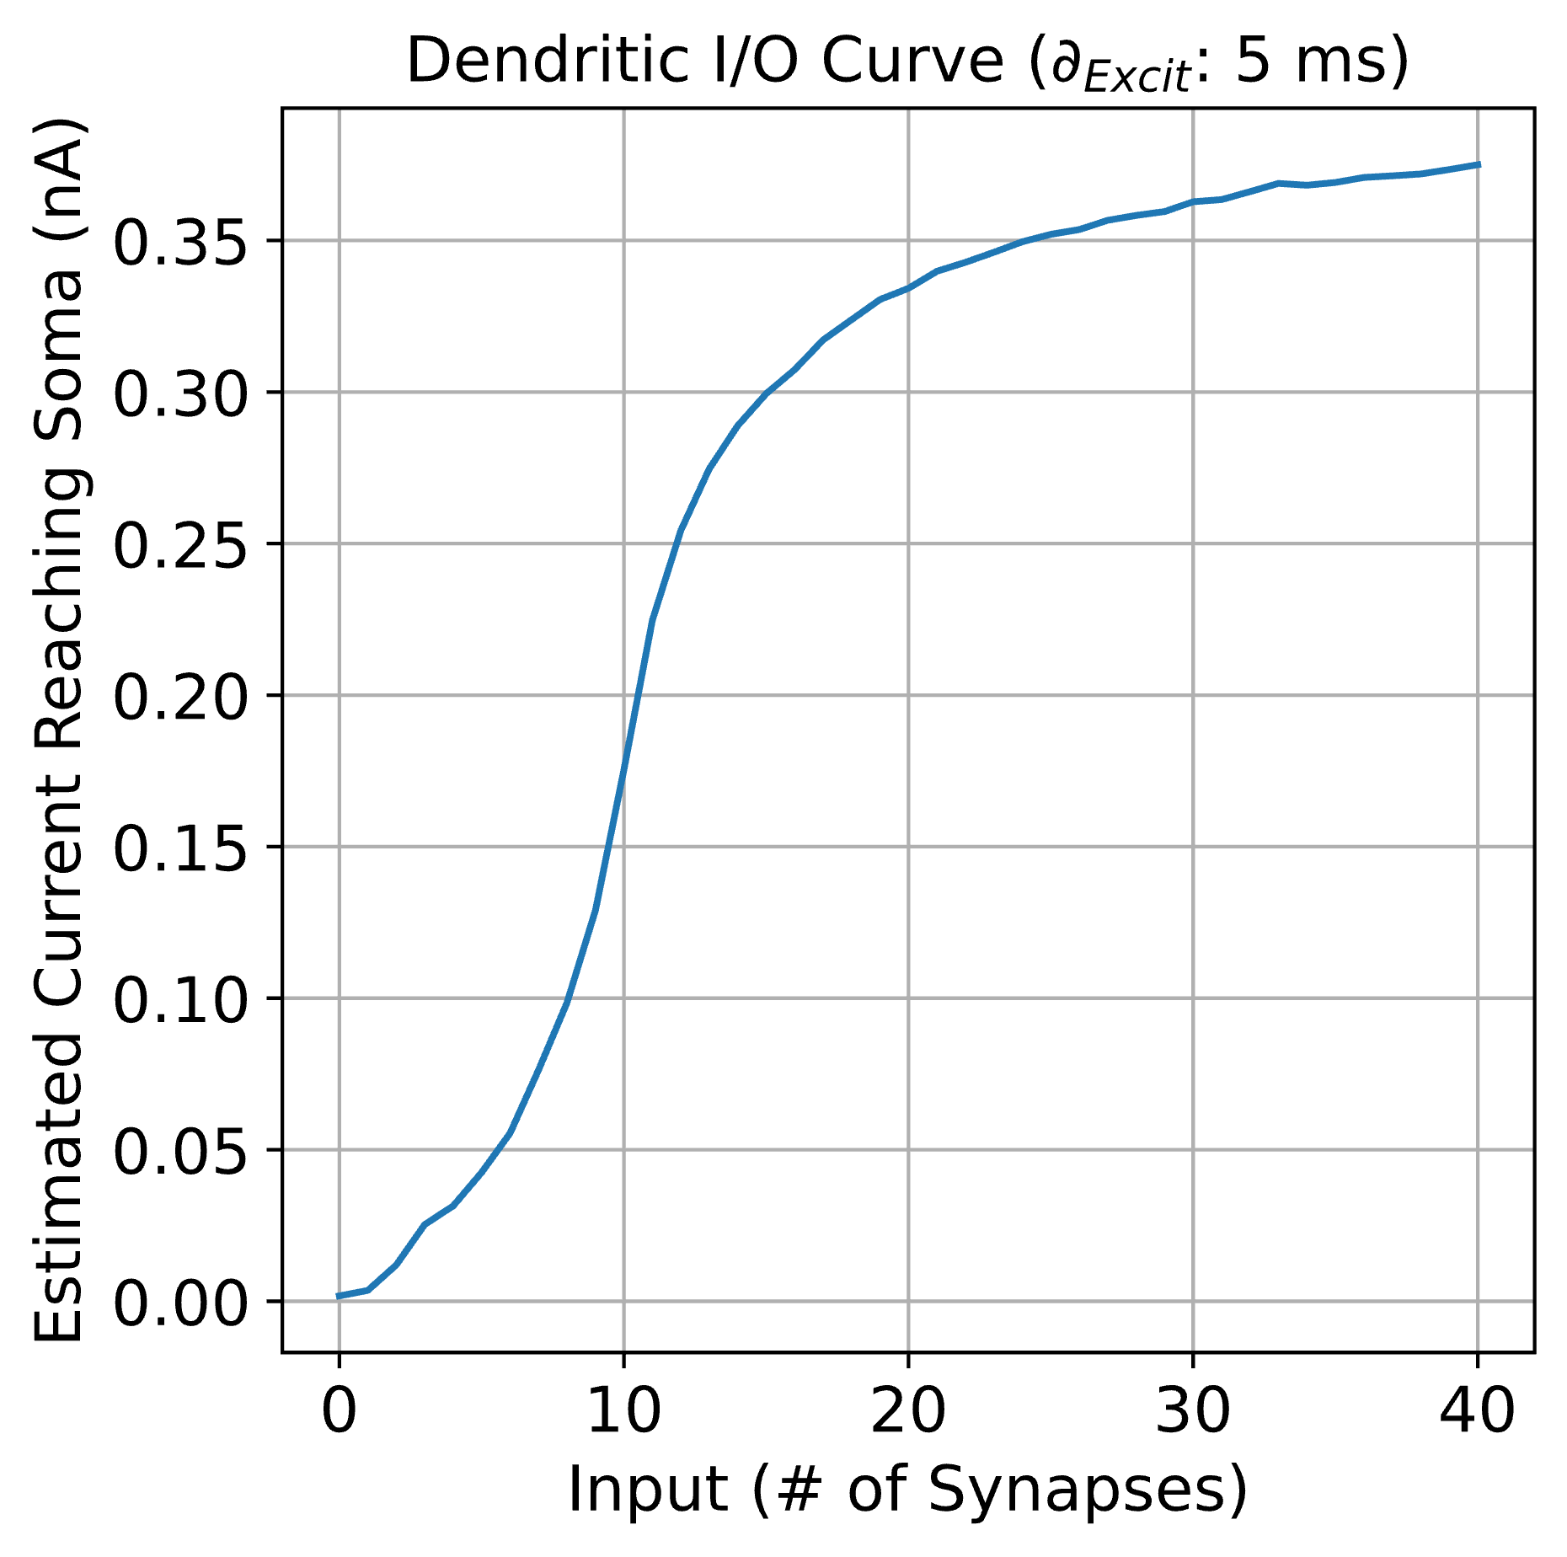
CASE #2: Time Offset: 5 ms
N_{Syn}: 0
N_{Syn}: 20

Slide 7
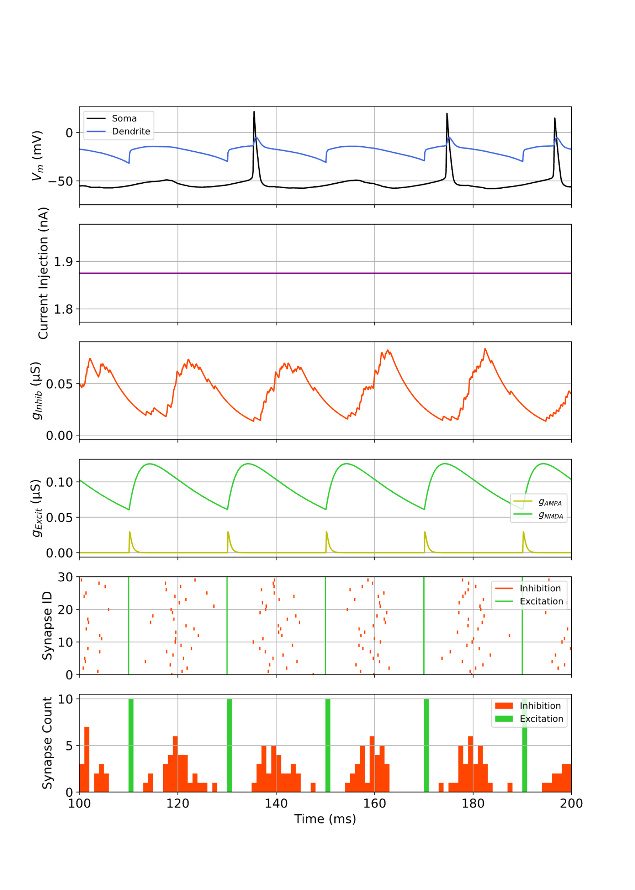
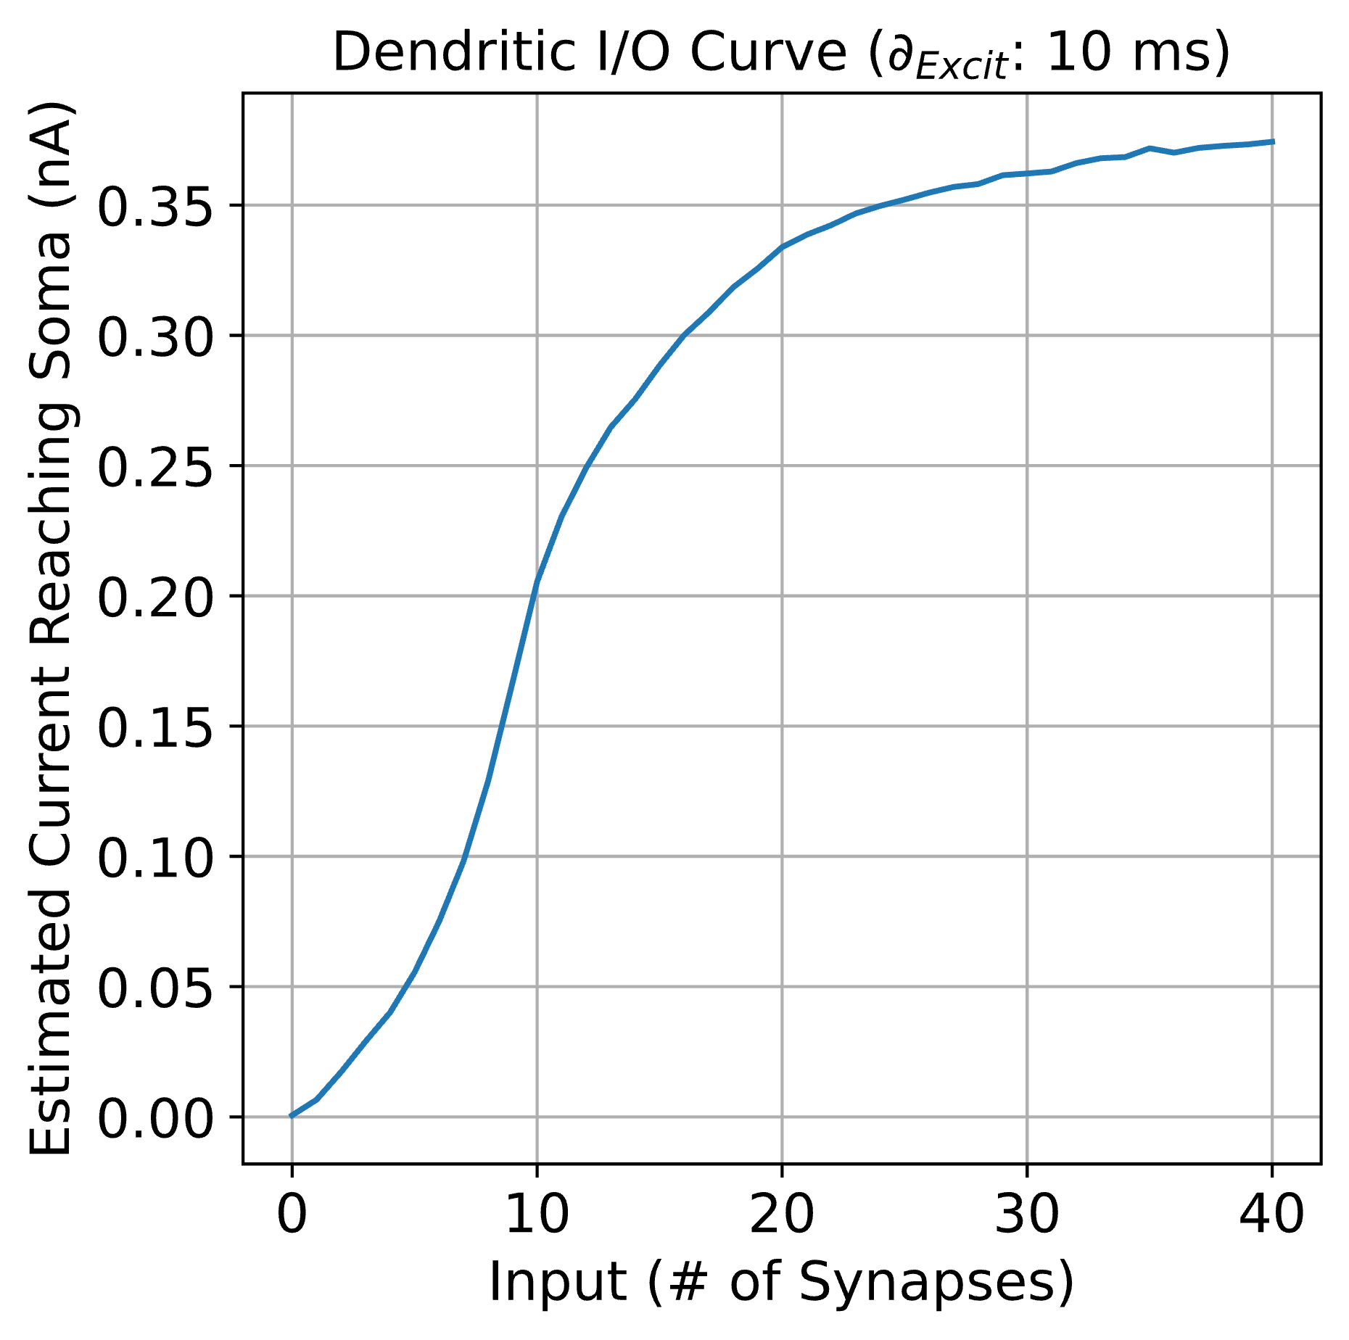
CASE #3: Time Offset: 10 ms
N_{Syn}: 0
N_{Syn}: 20

Slide 8
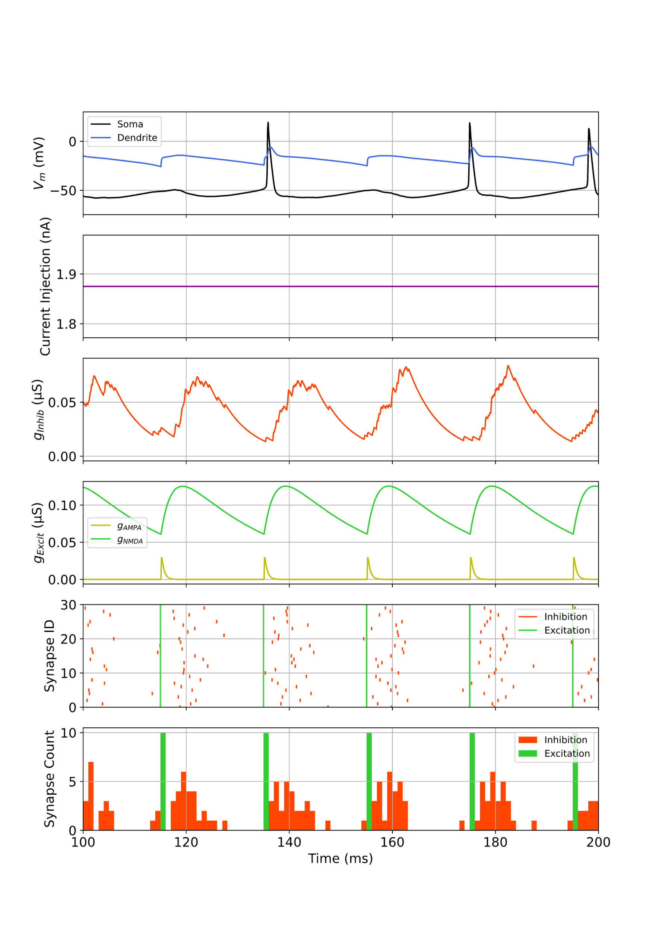
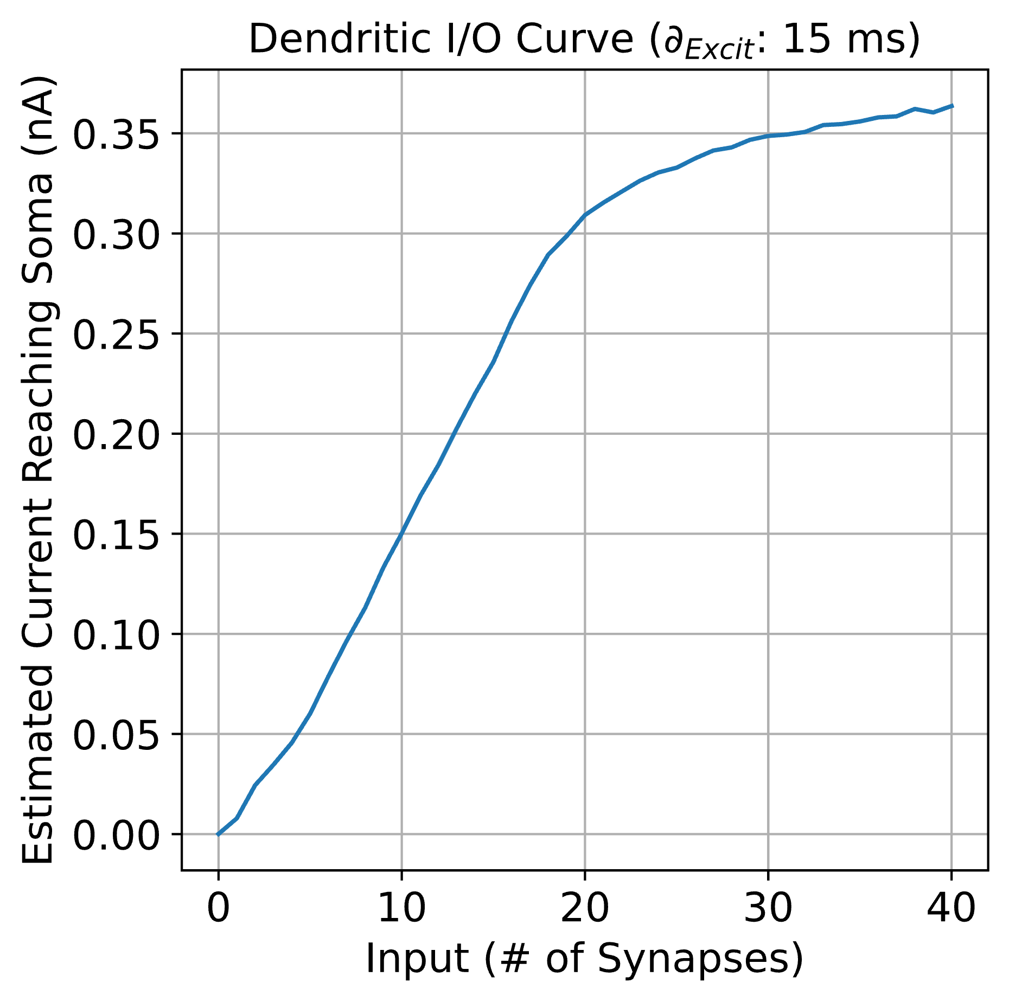
CASE #4: Time Offset: 15 ms
N_{Syn}: 0
N_{Syn}: 20

Slide 9
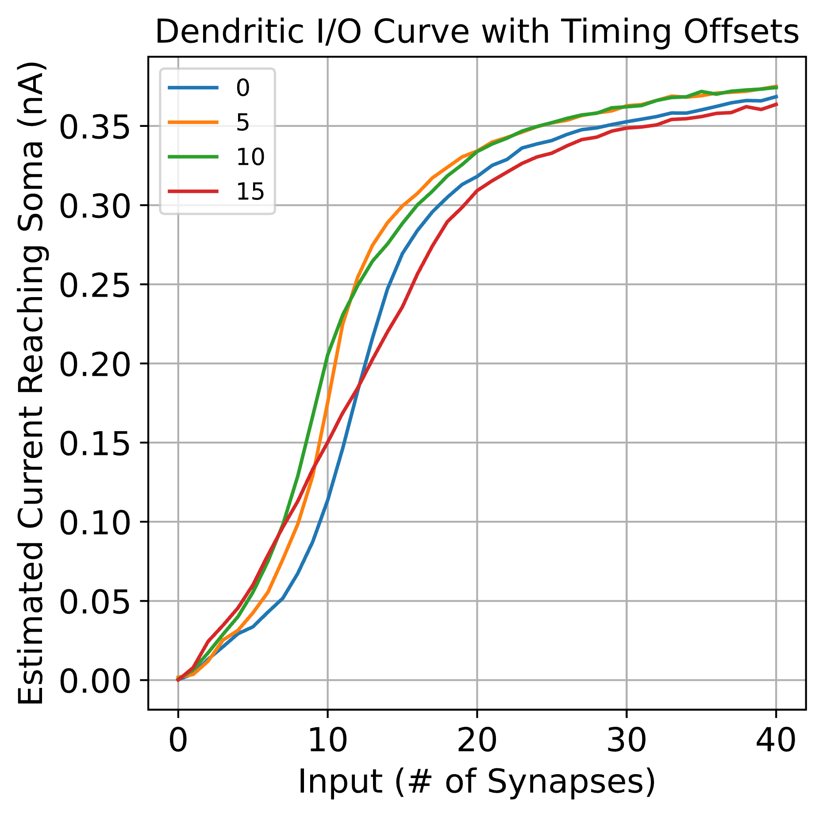
Compiled I/O Curves

Slide 10
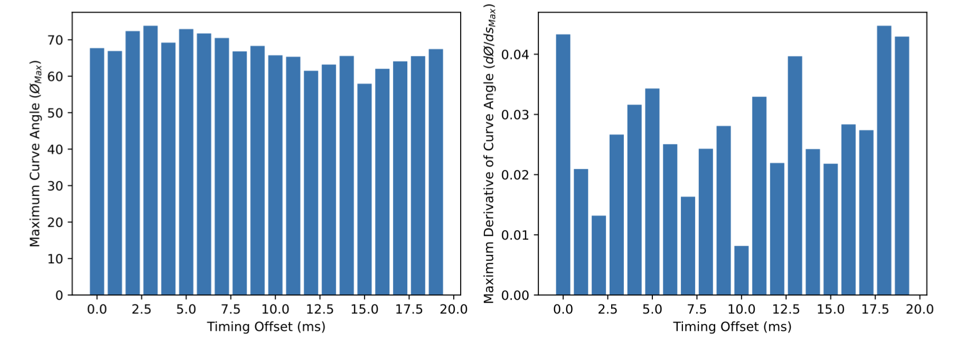
Nonlinearity Scores

Slide 11
High Conductance Conditions
g_{GABAa}: 0.015 µS

Slide 12
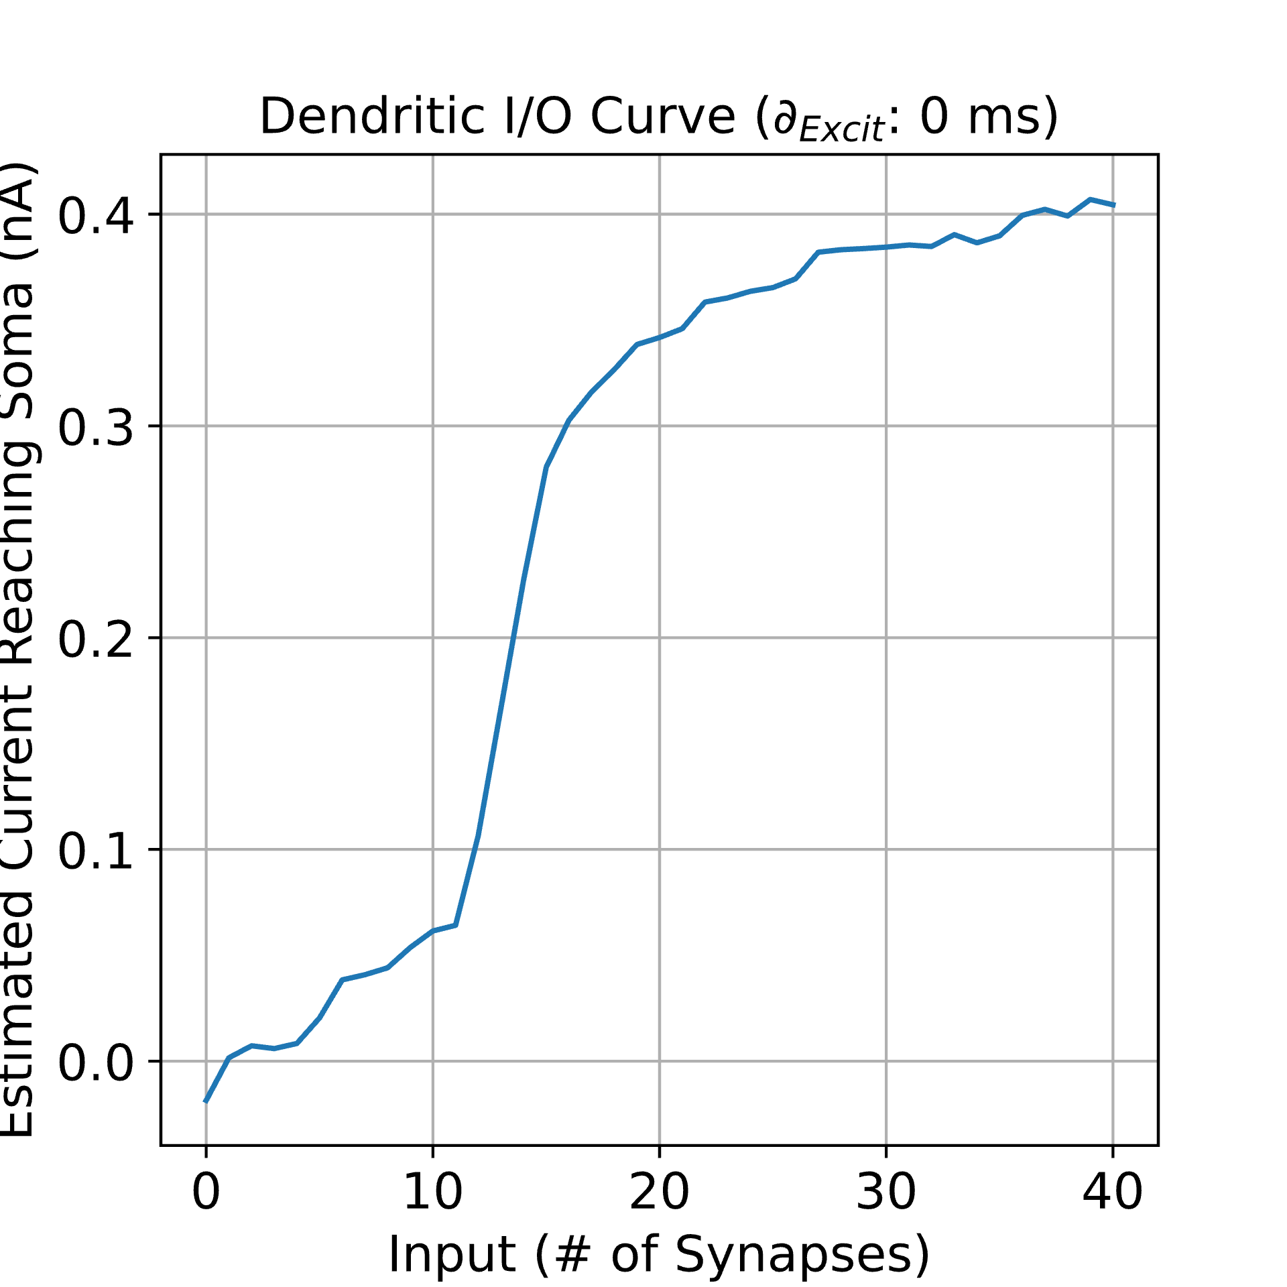
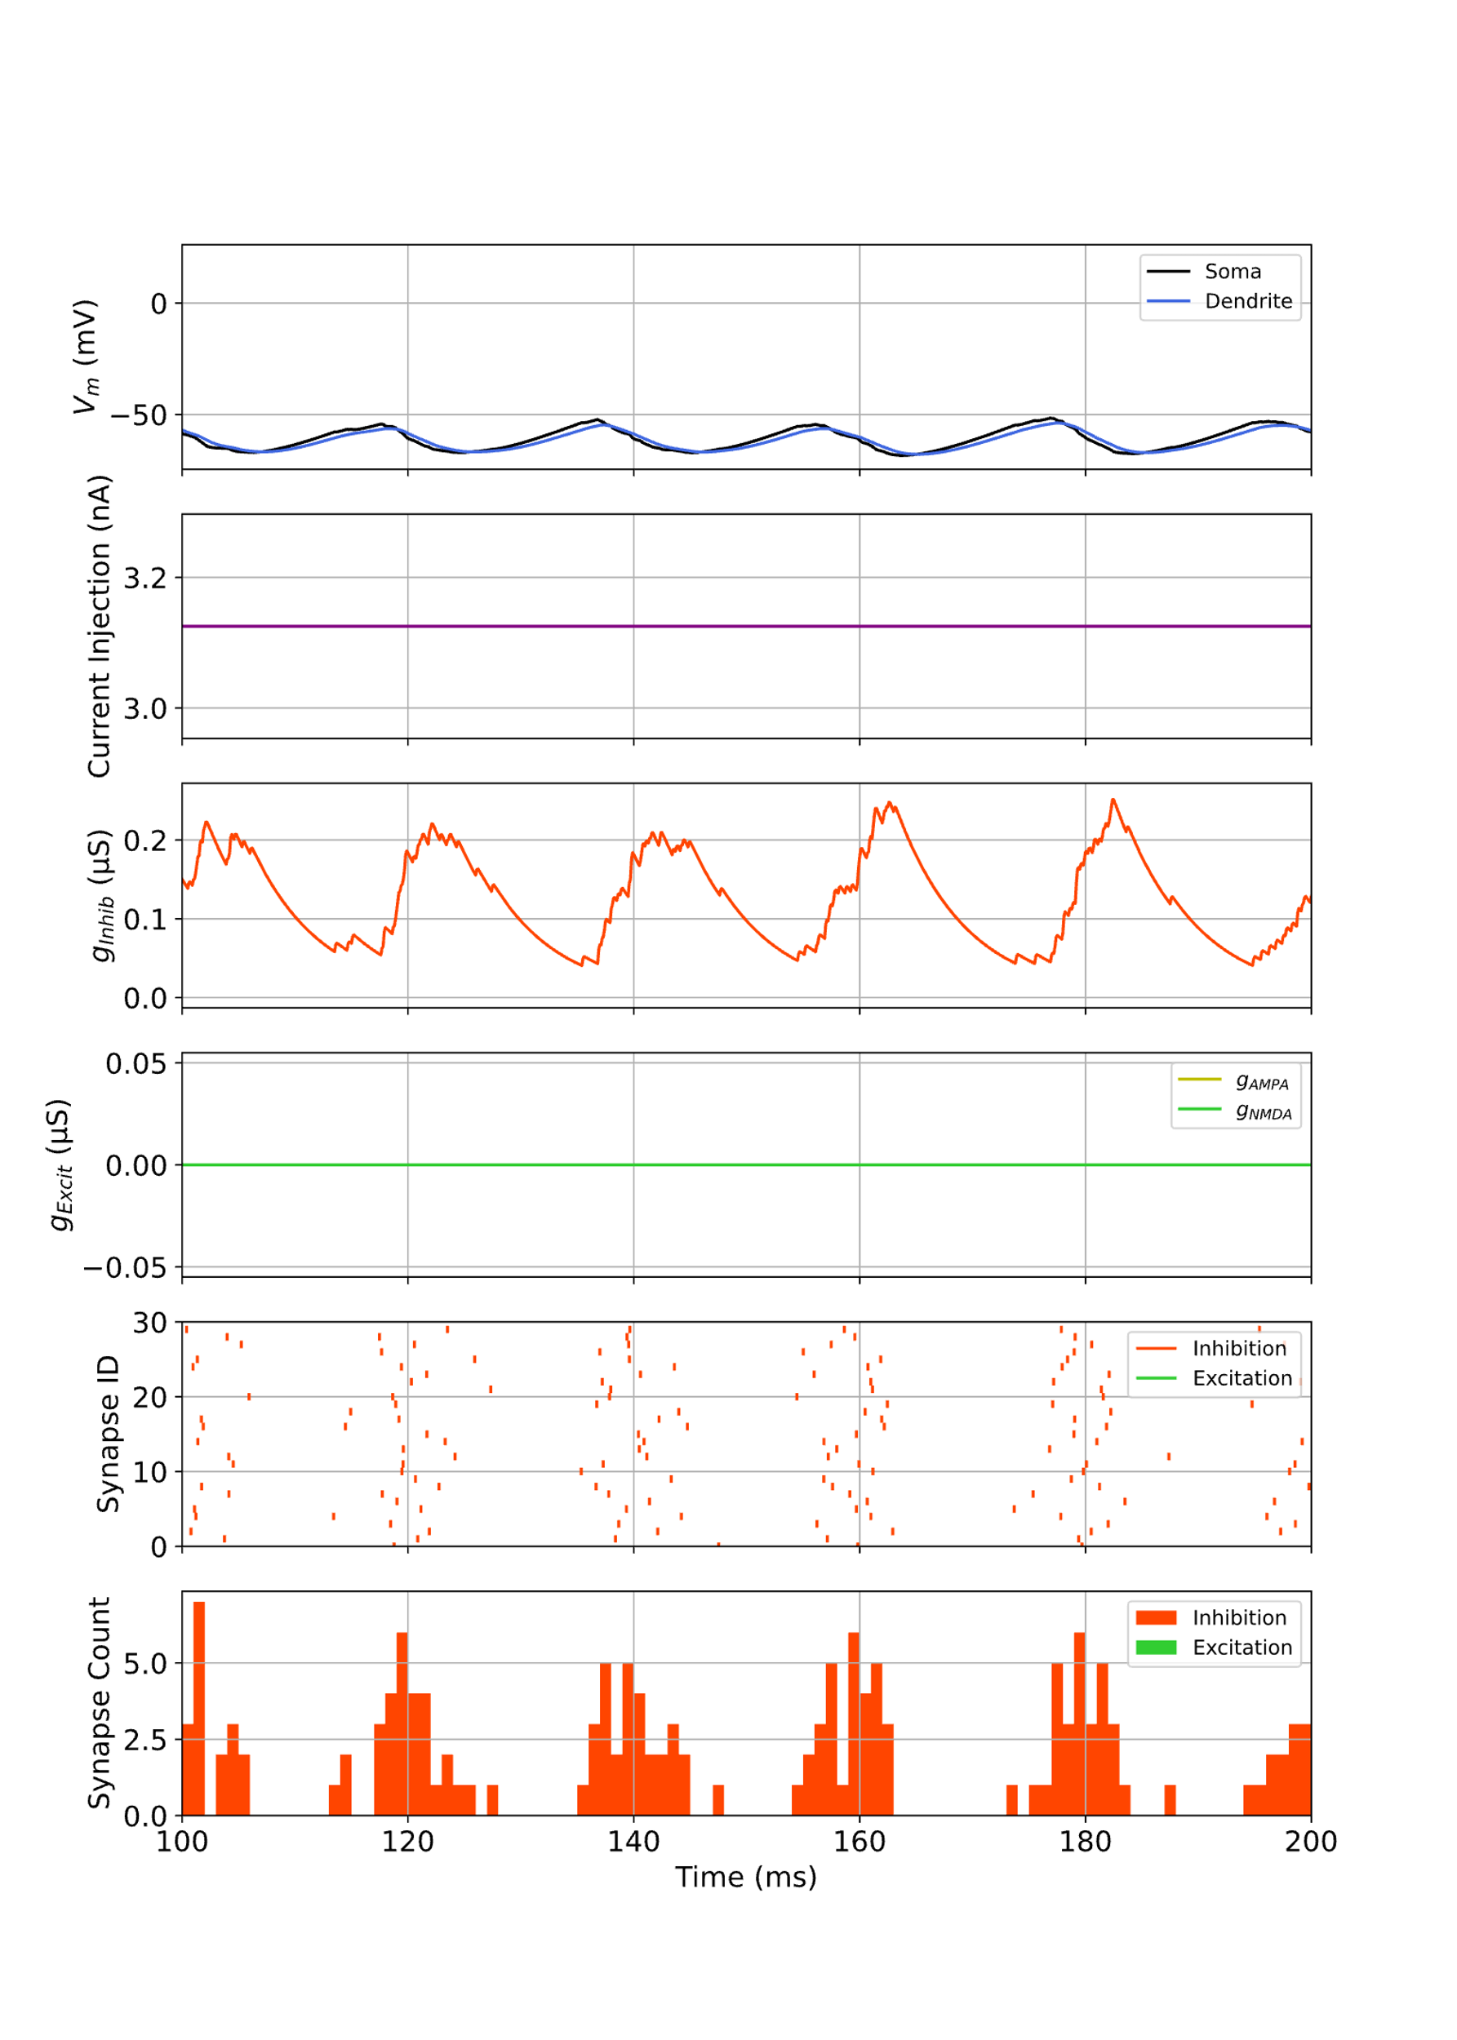
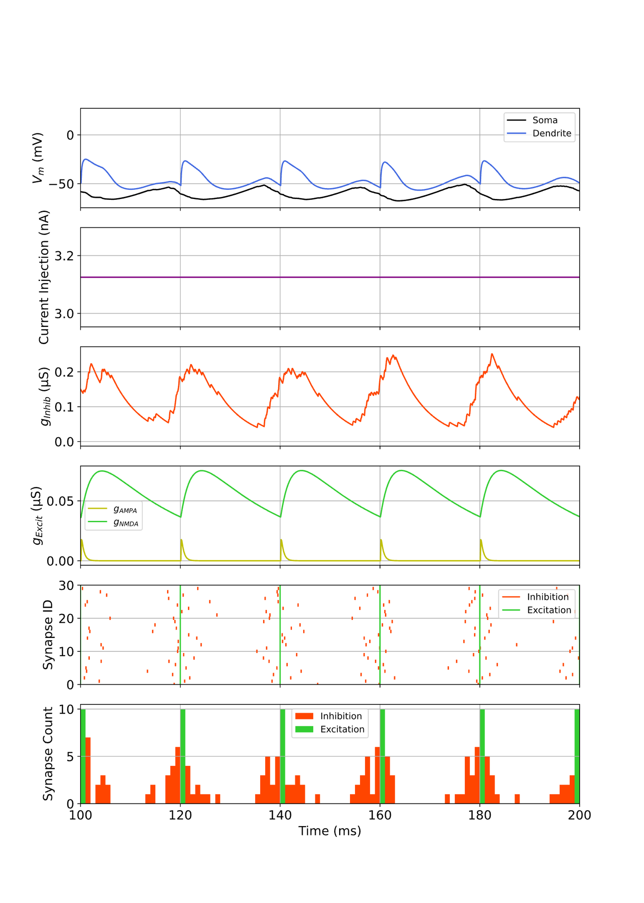
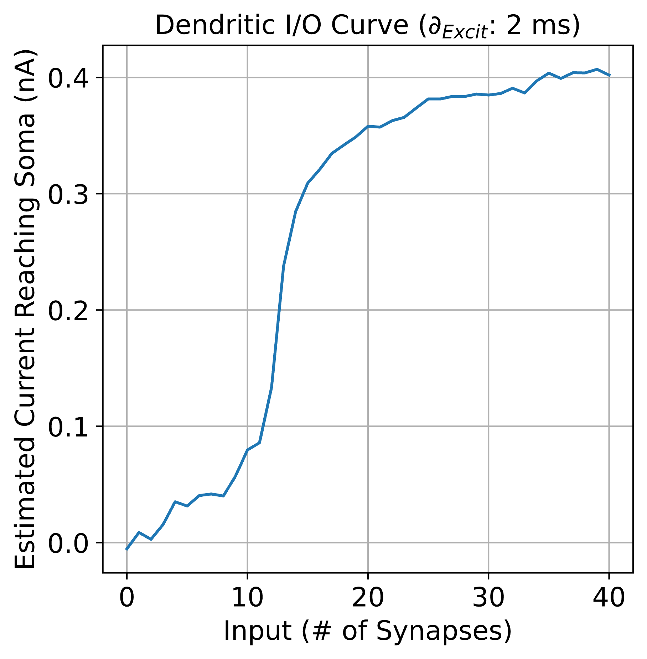
CASE #1: Time Offset: 0 ms
N_{Syn}: 0
N_{Syn}: 12

Slide 13
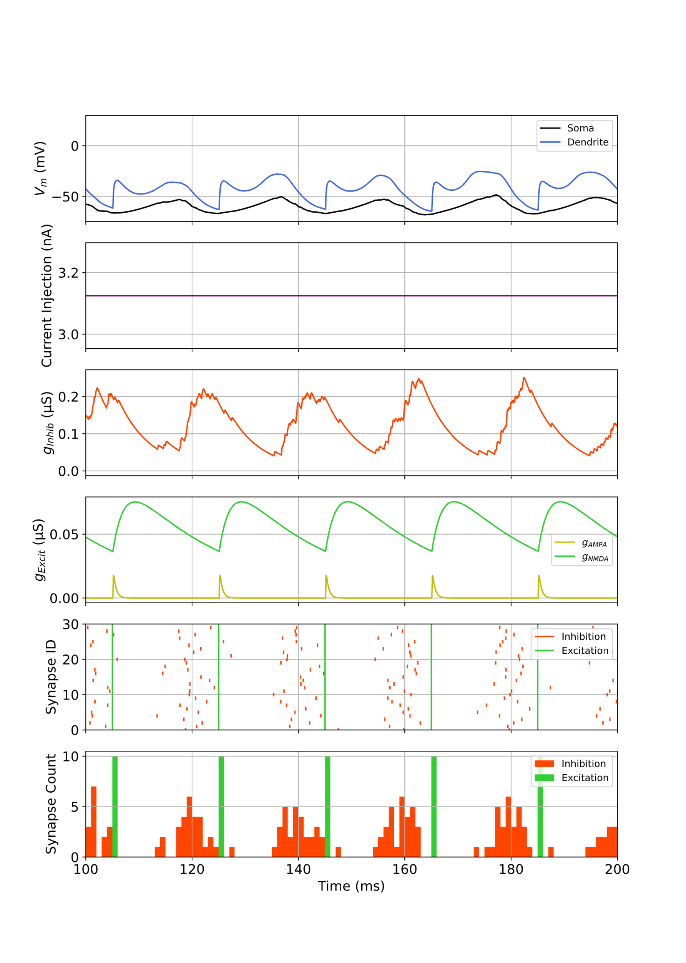
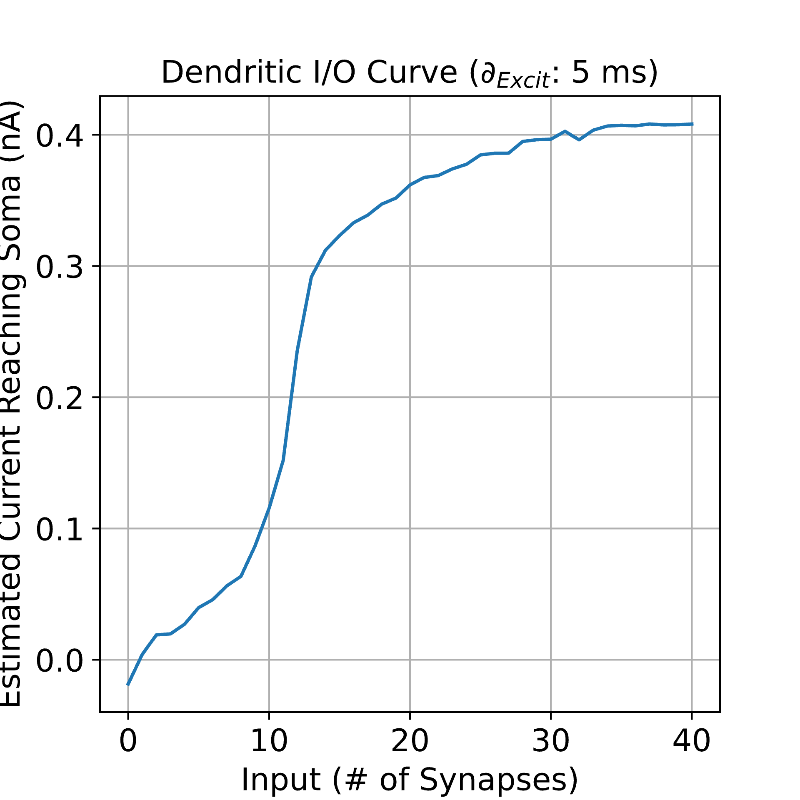
CASE #2: Time Offset: 5 ms
N_{Syn}: 0
N_{Syn}: 12

Slide 14
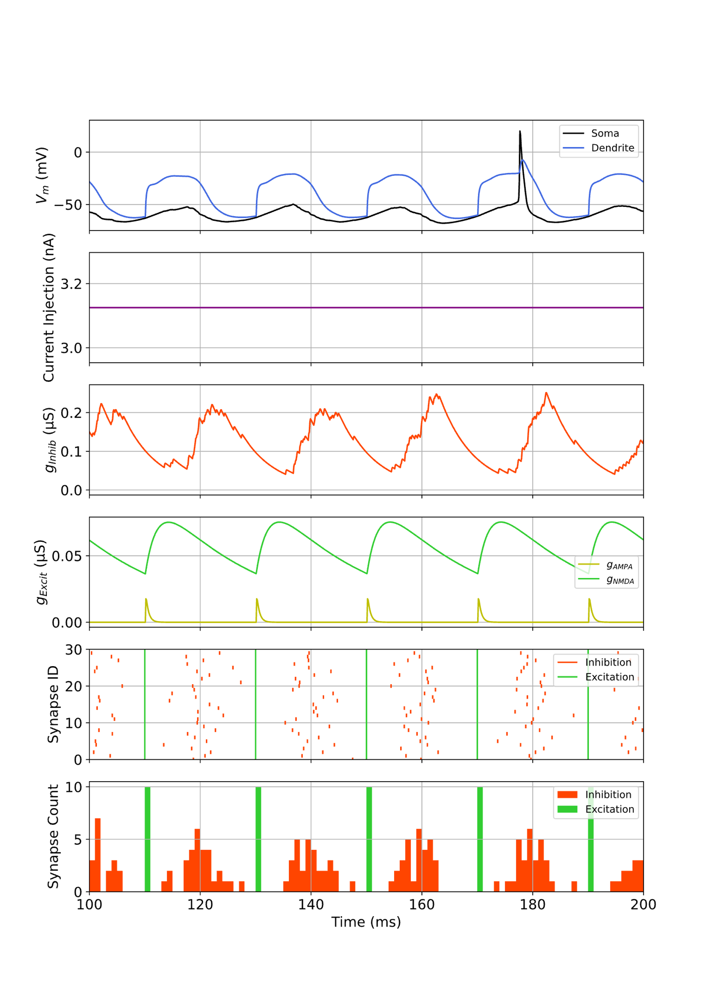
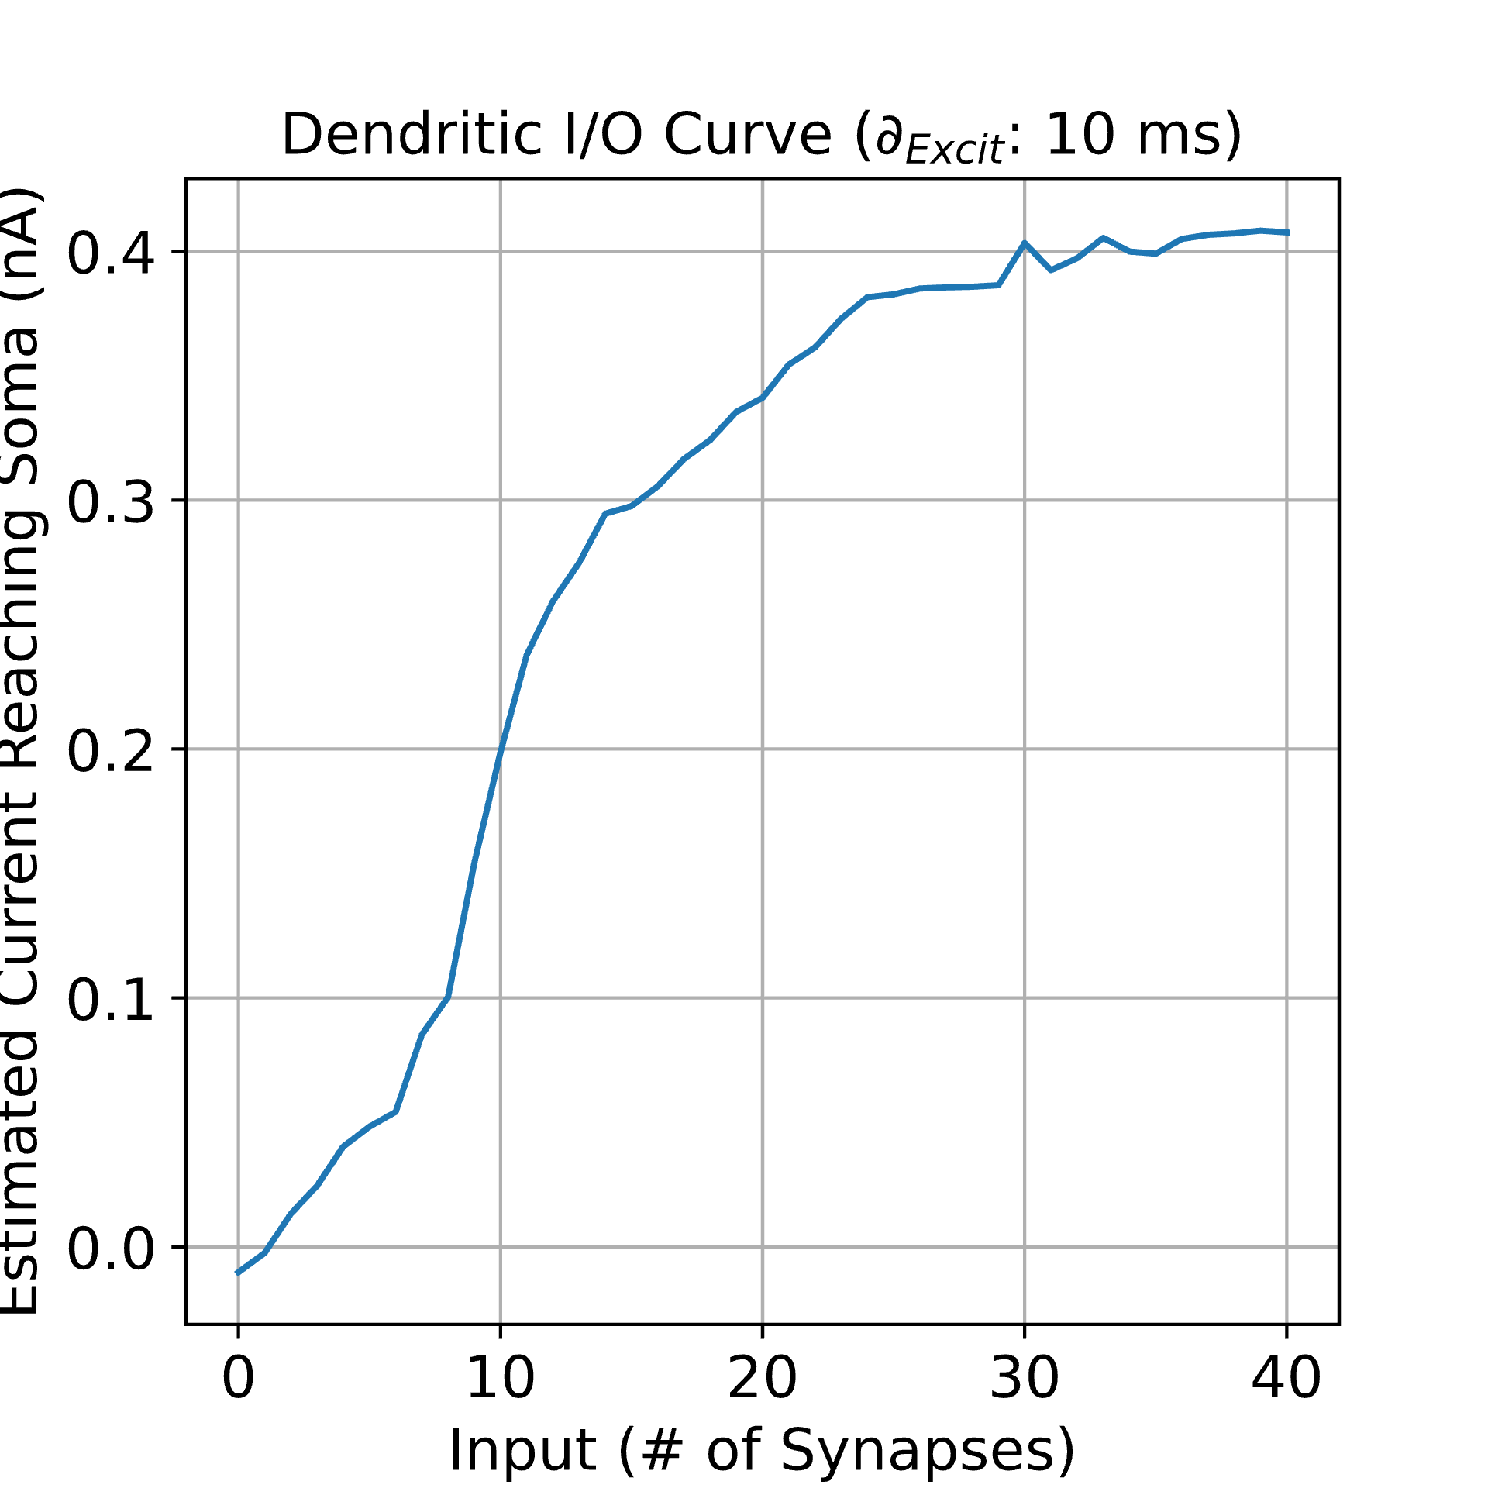
CASE #3: Time Offset: 10 ms
N_{Syn}: 0
N_{Syn}: 12

Slide 15
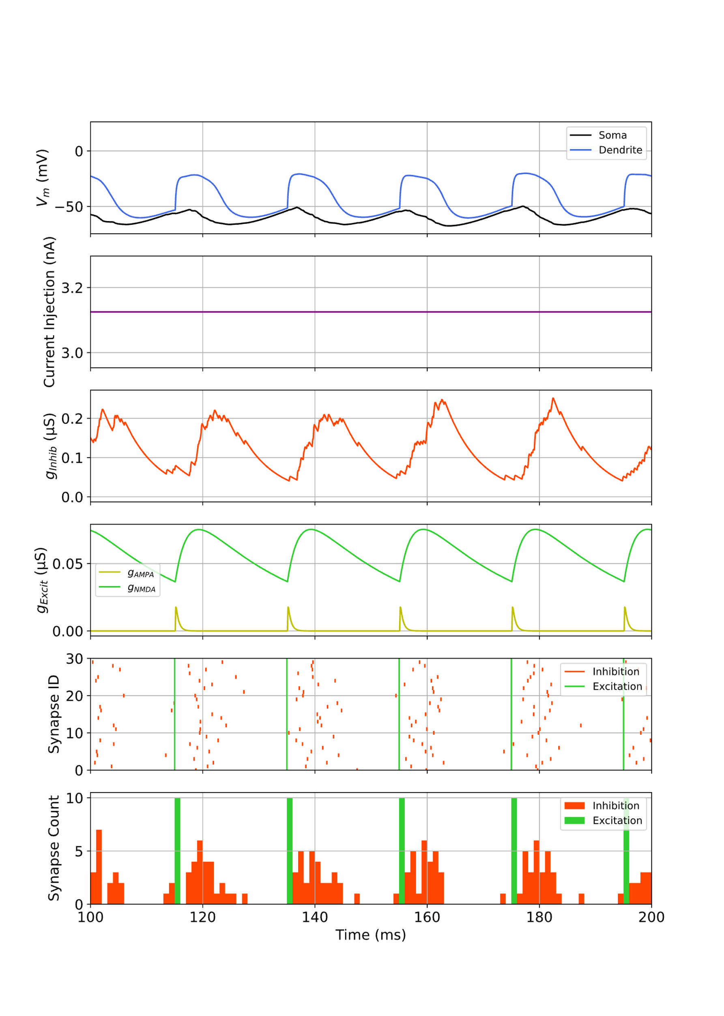
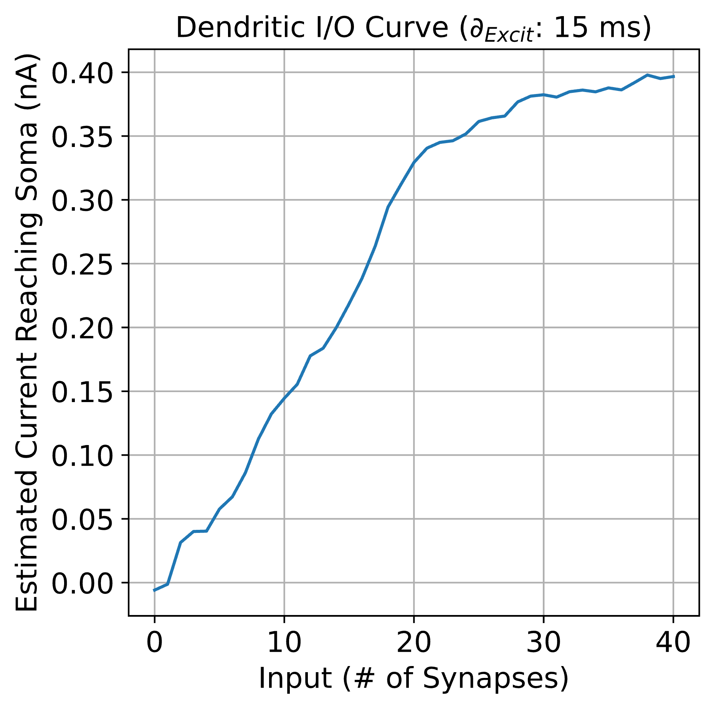
CASE #4: Time Offset: 15 ms
N_{Syn}: 0
N_{Syn}: 12

Slide 16
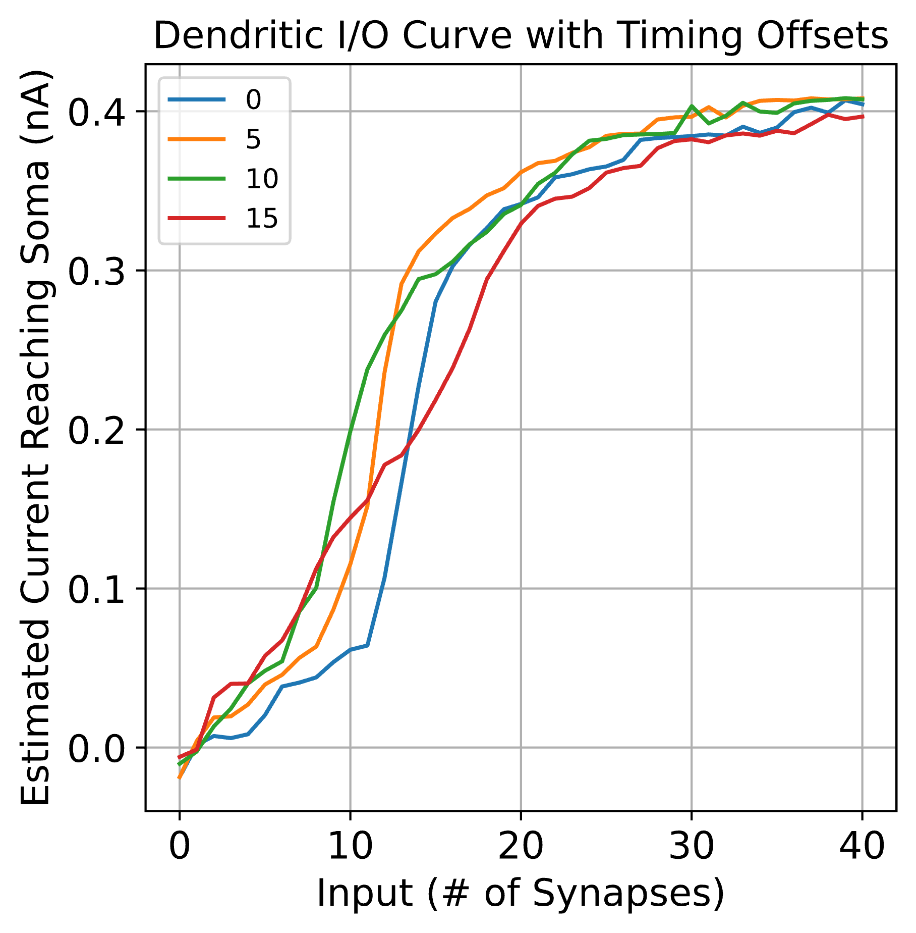
Compiled I/O Curve

Slide 17
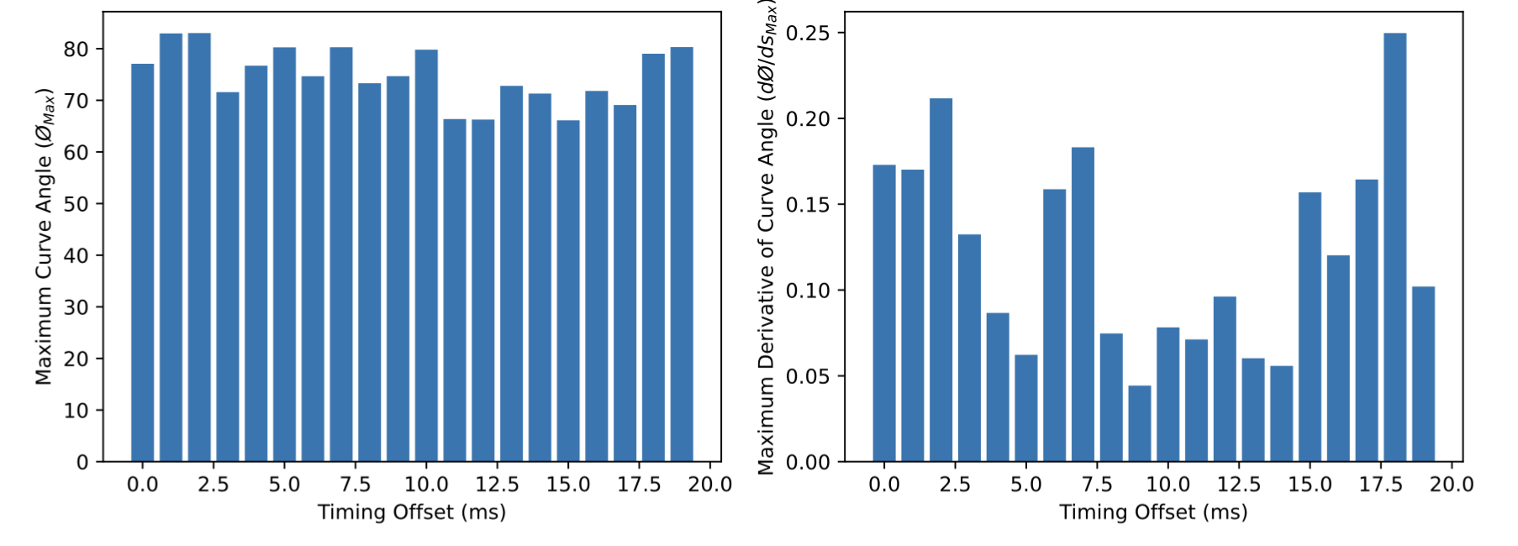
Nonlinearity Scores

Slide 18
High Conductance + Shorter Tau Conditions
g_{GABAa}: 0.015 µS
tau_{NMDA}: 18.8 10 ms

Slide 19
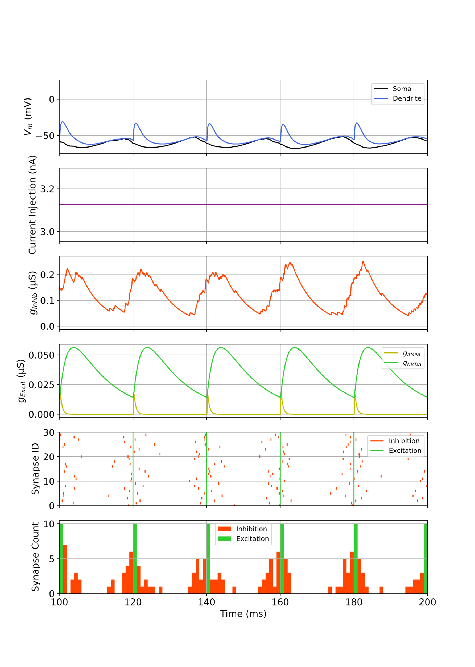
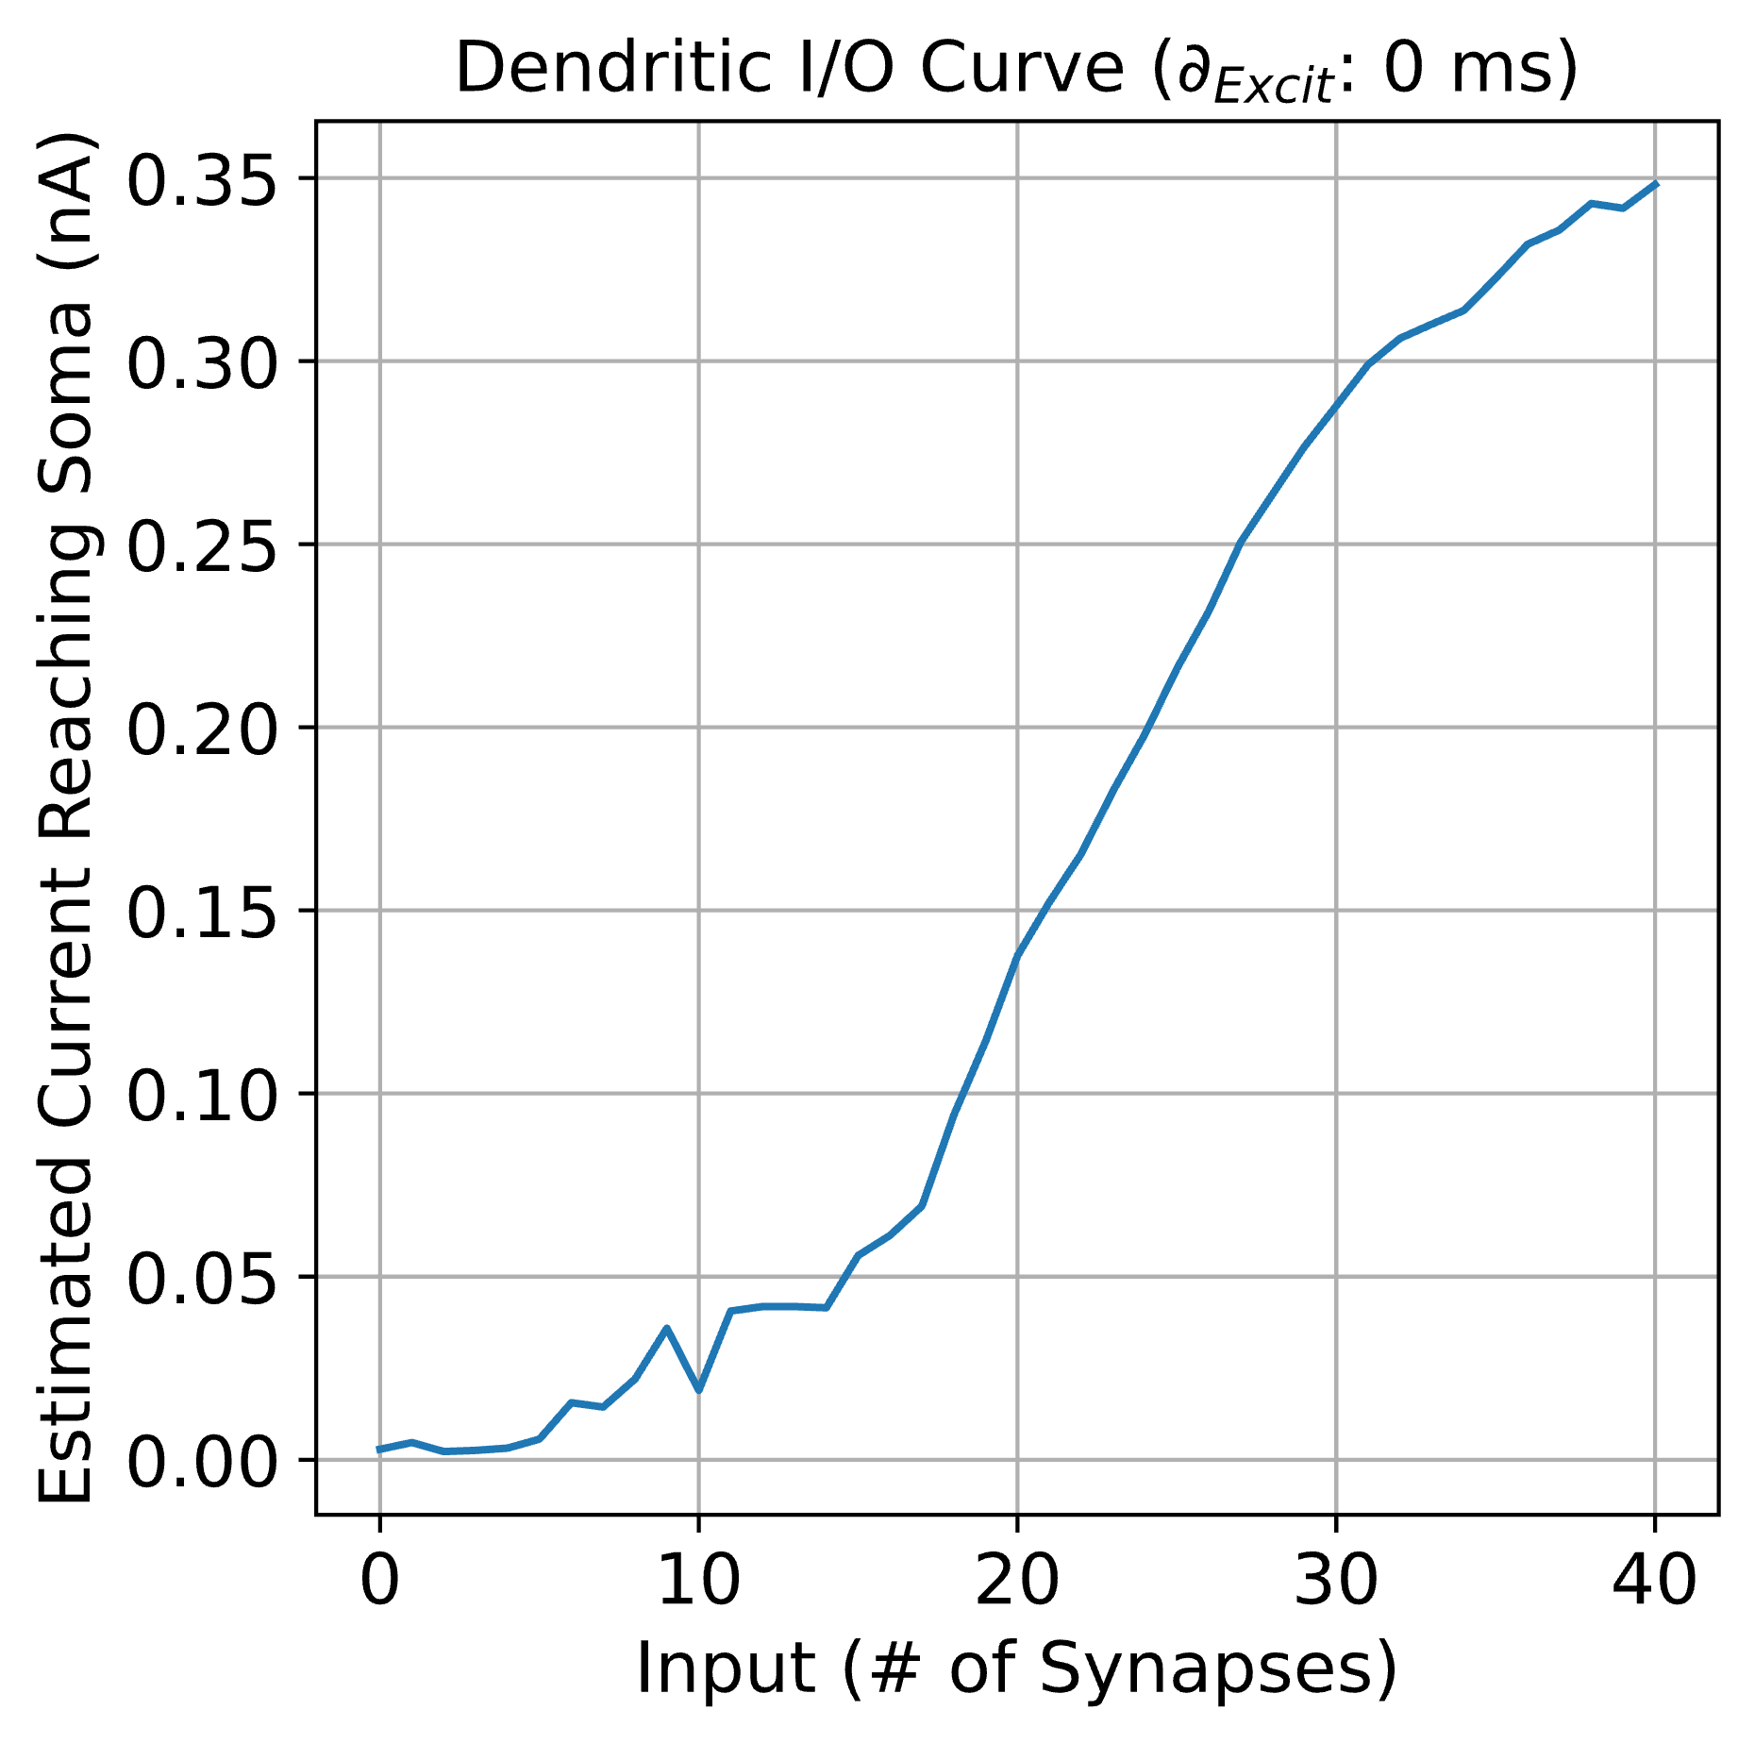
CASE #1: Time Offset: 0 ms
N_{Syn}: 0
N_{Syn}: 12

Slide 20
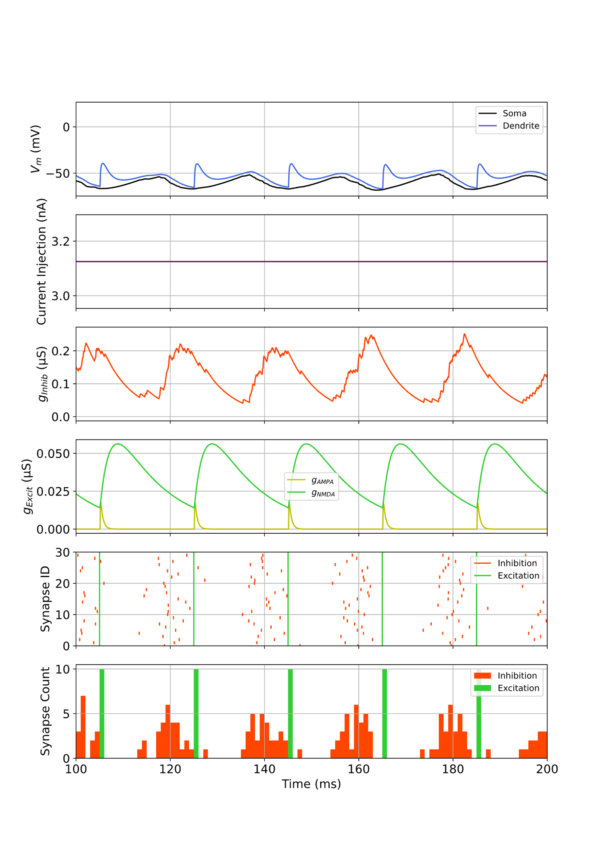
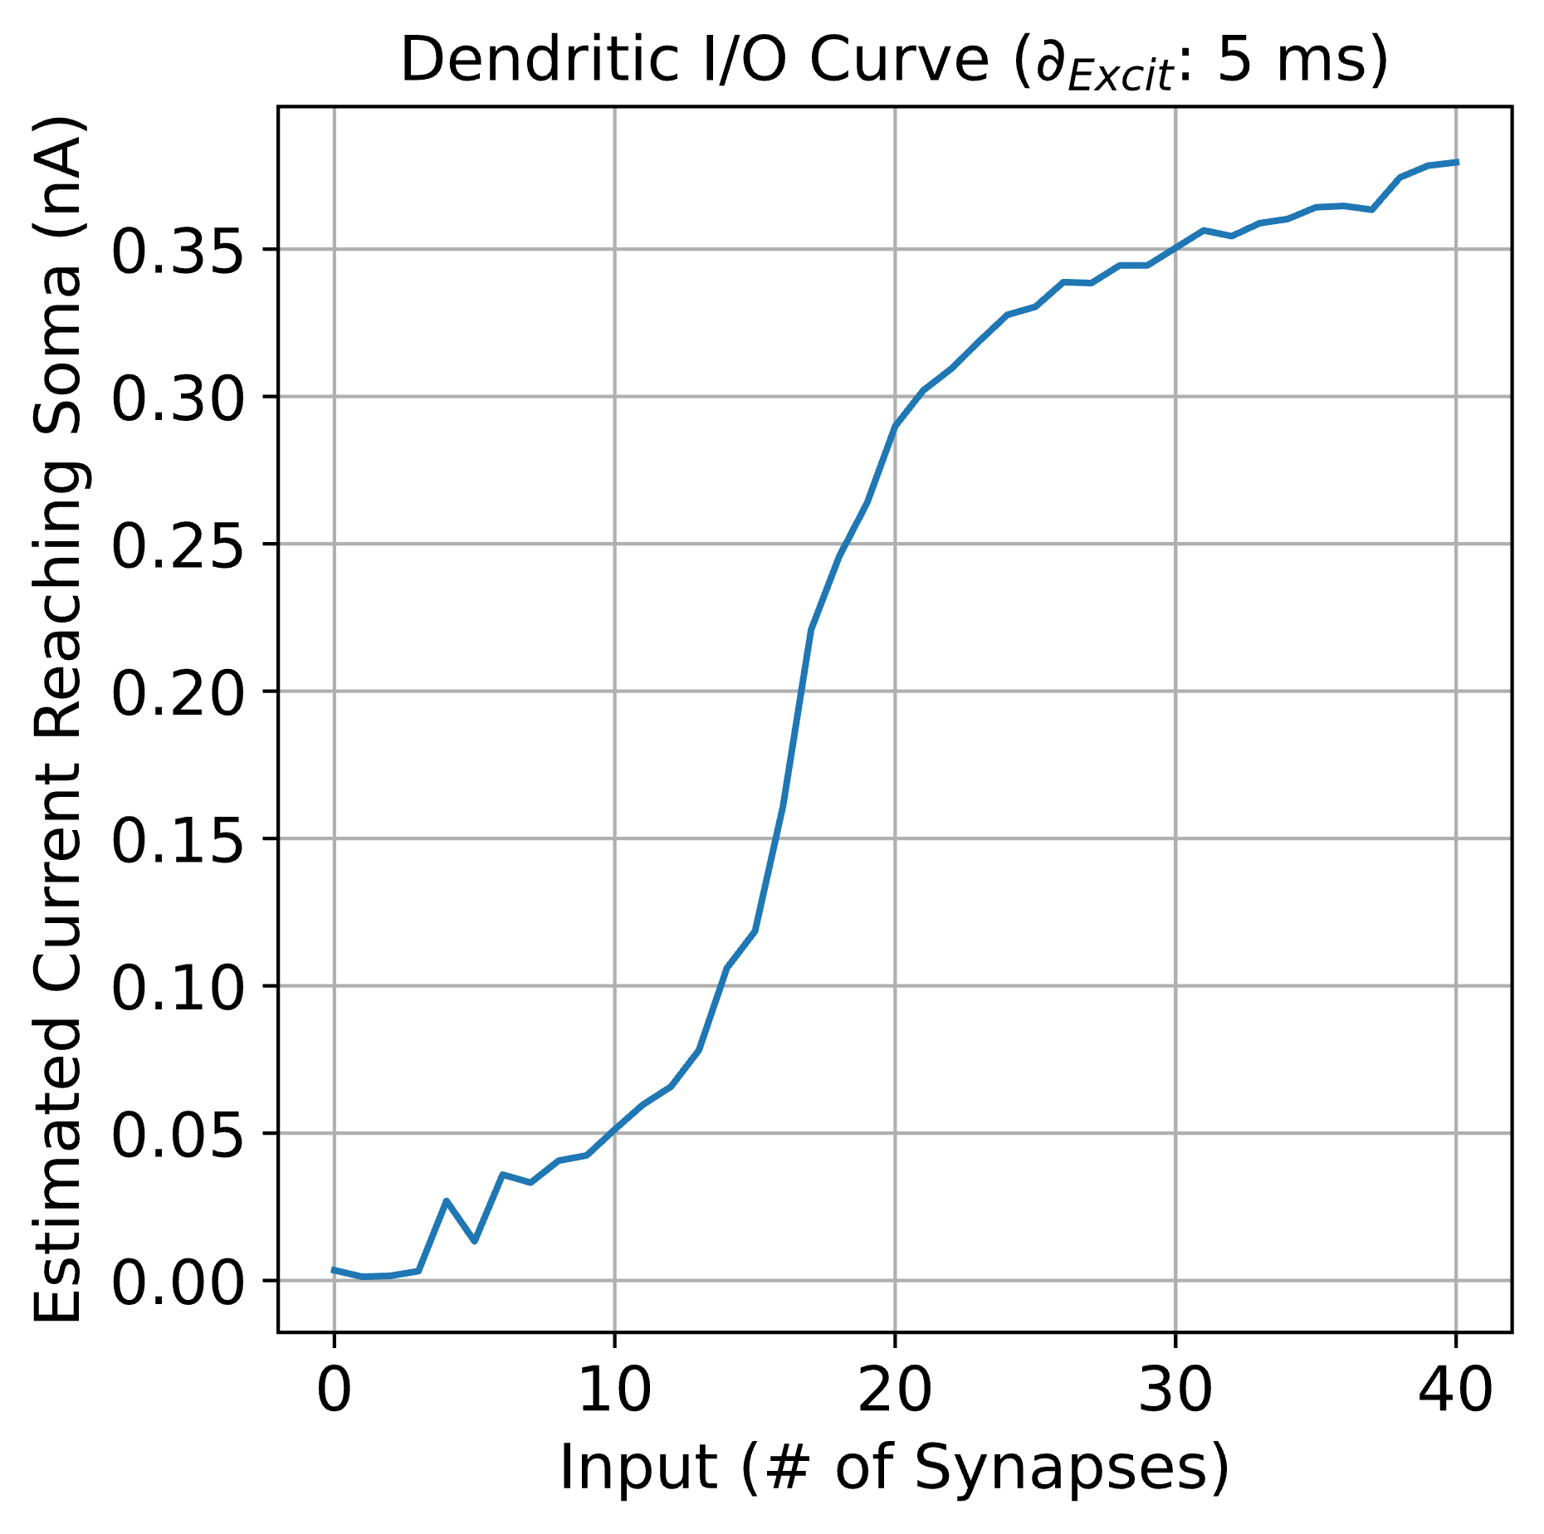
CASE #2: Time Offset: 5 ms
N_{Syn}: 0
N_{Syn}: 12

Slide 21
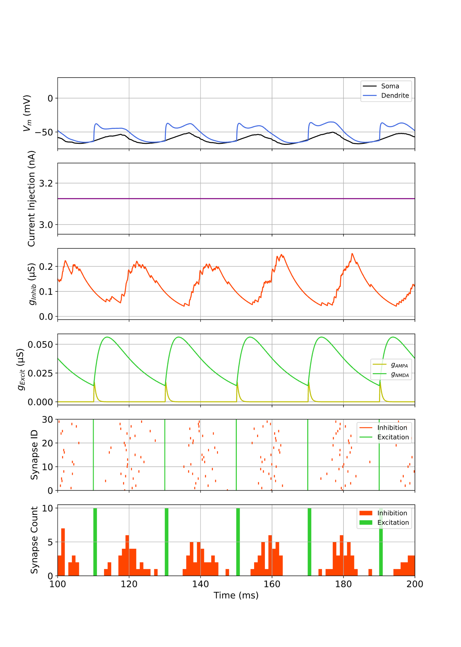
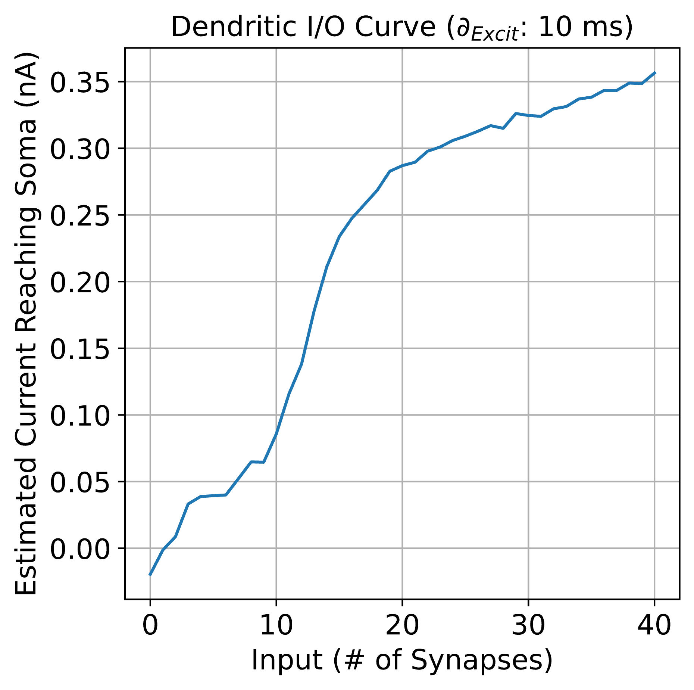
CASE #3: Time Offset: 10 ms
N_{Syn}: 0
N_{Syn}: 12

Slide 22
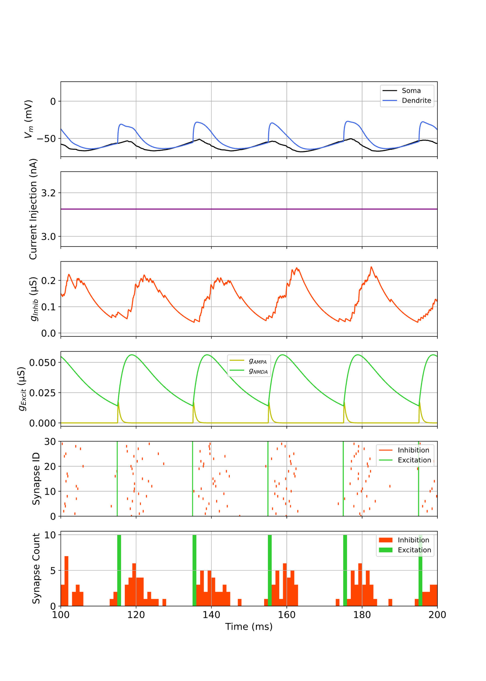
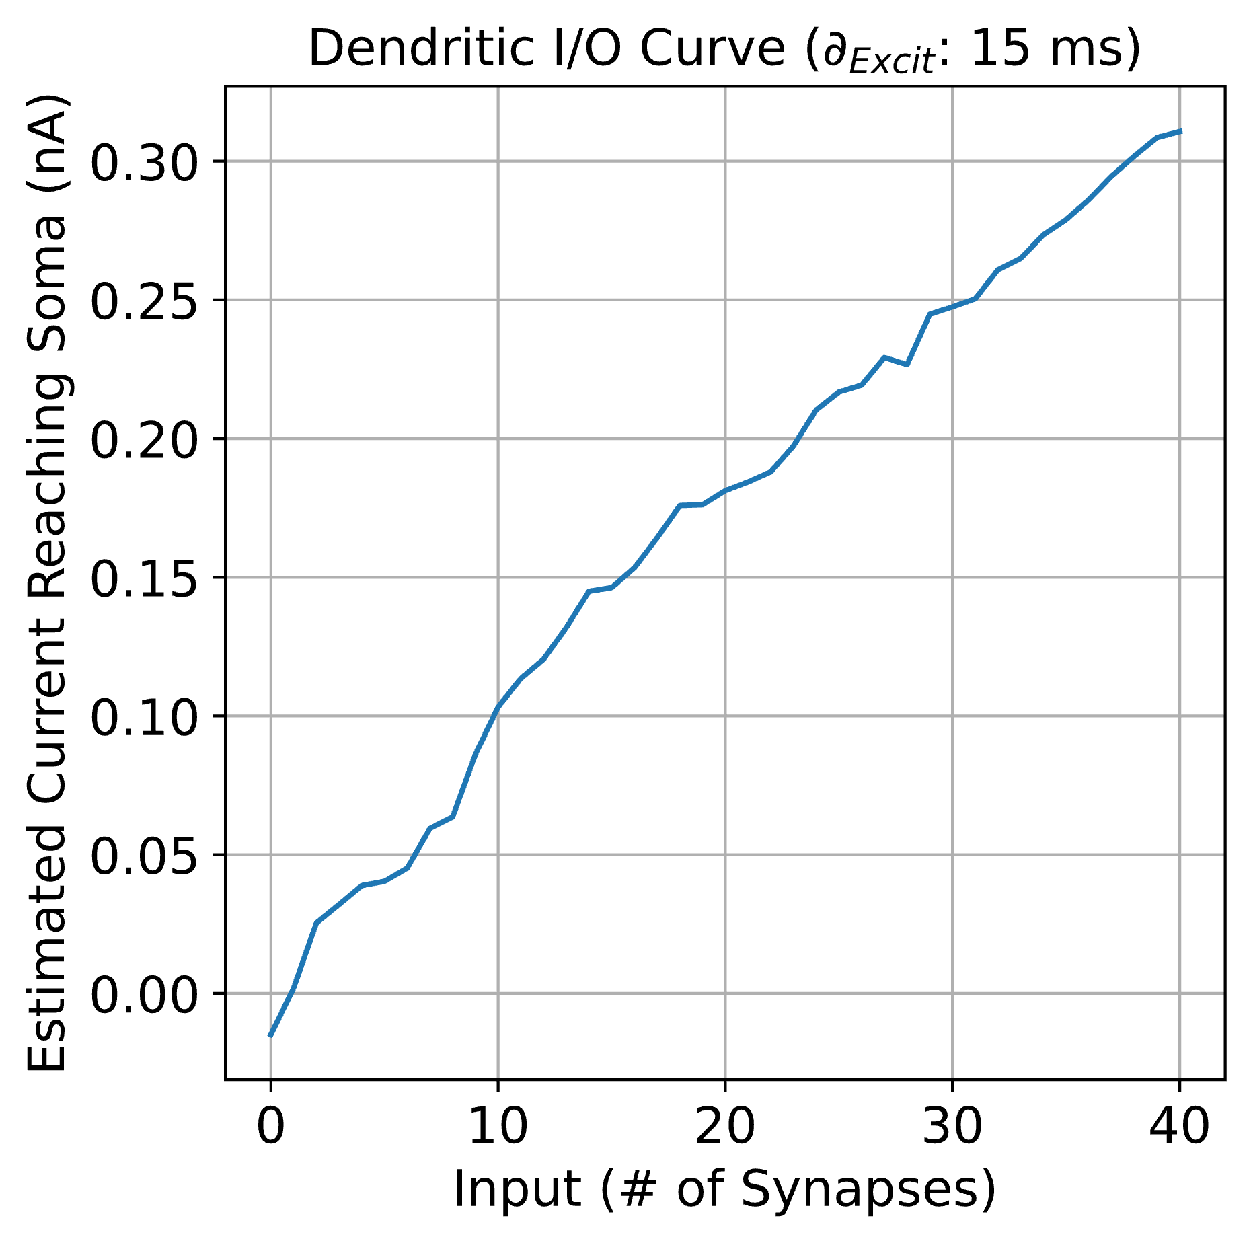
CASE #4: Time Offset: 15 ms
N_{Syn}: 0
N_{Syn}: 12

Slide 23
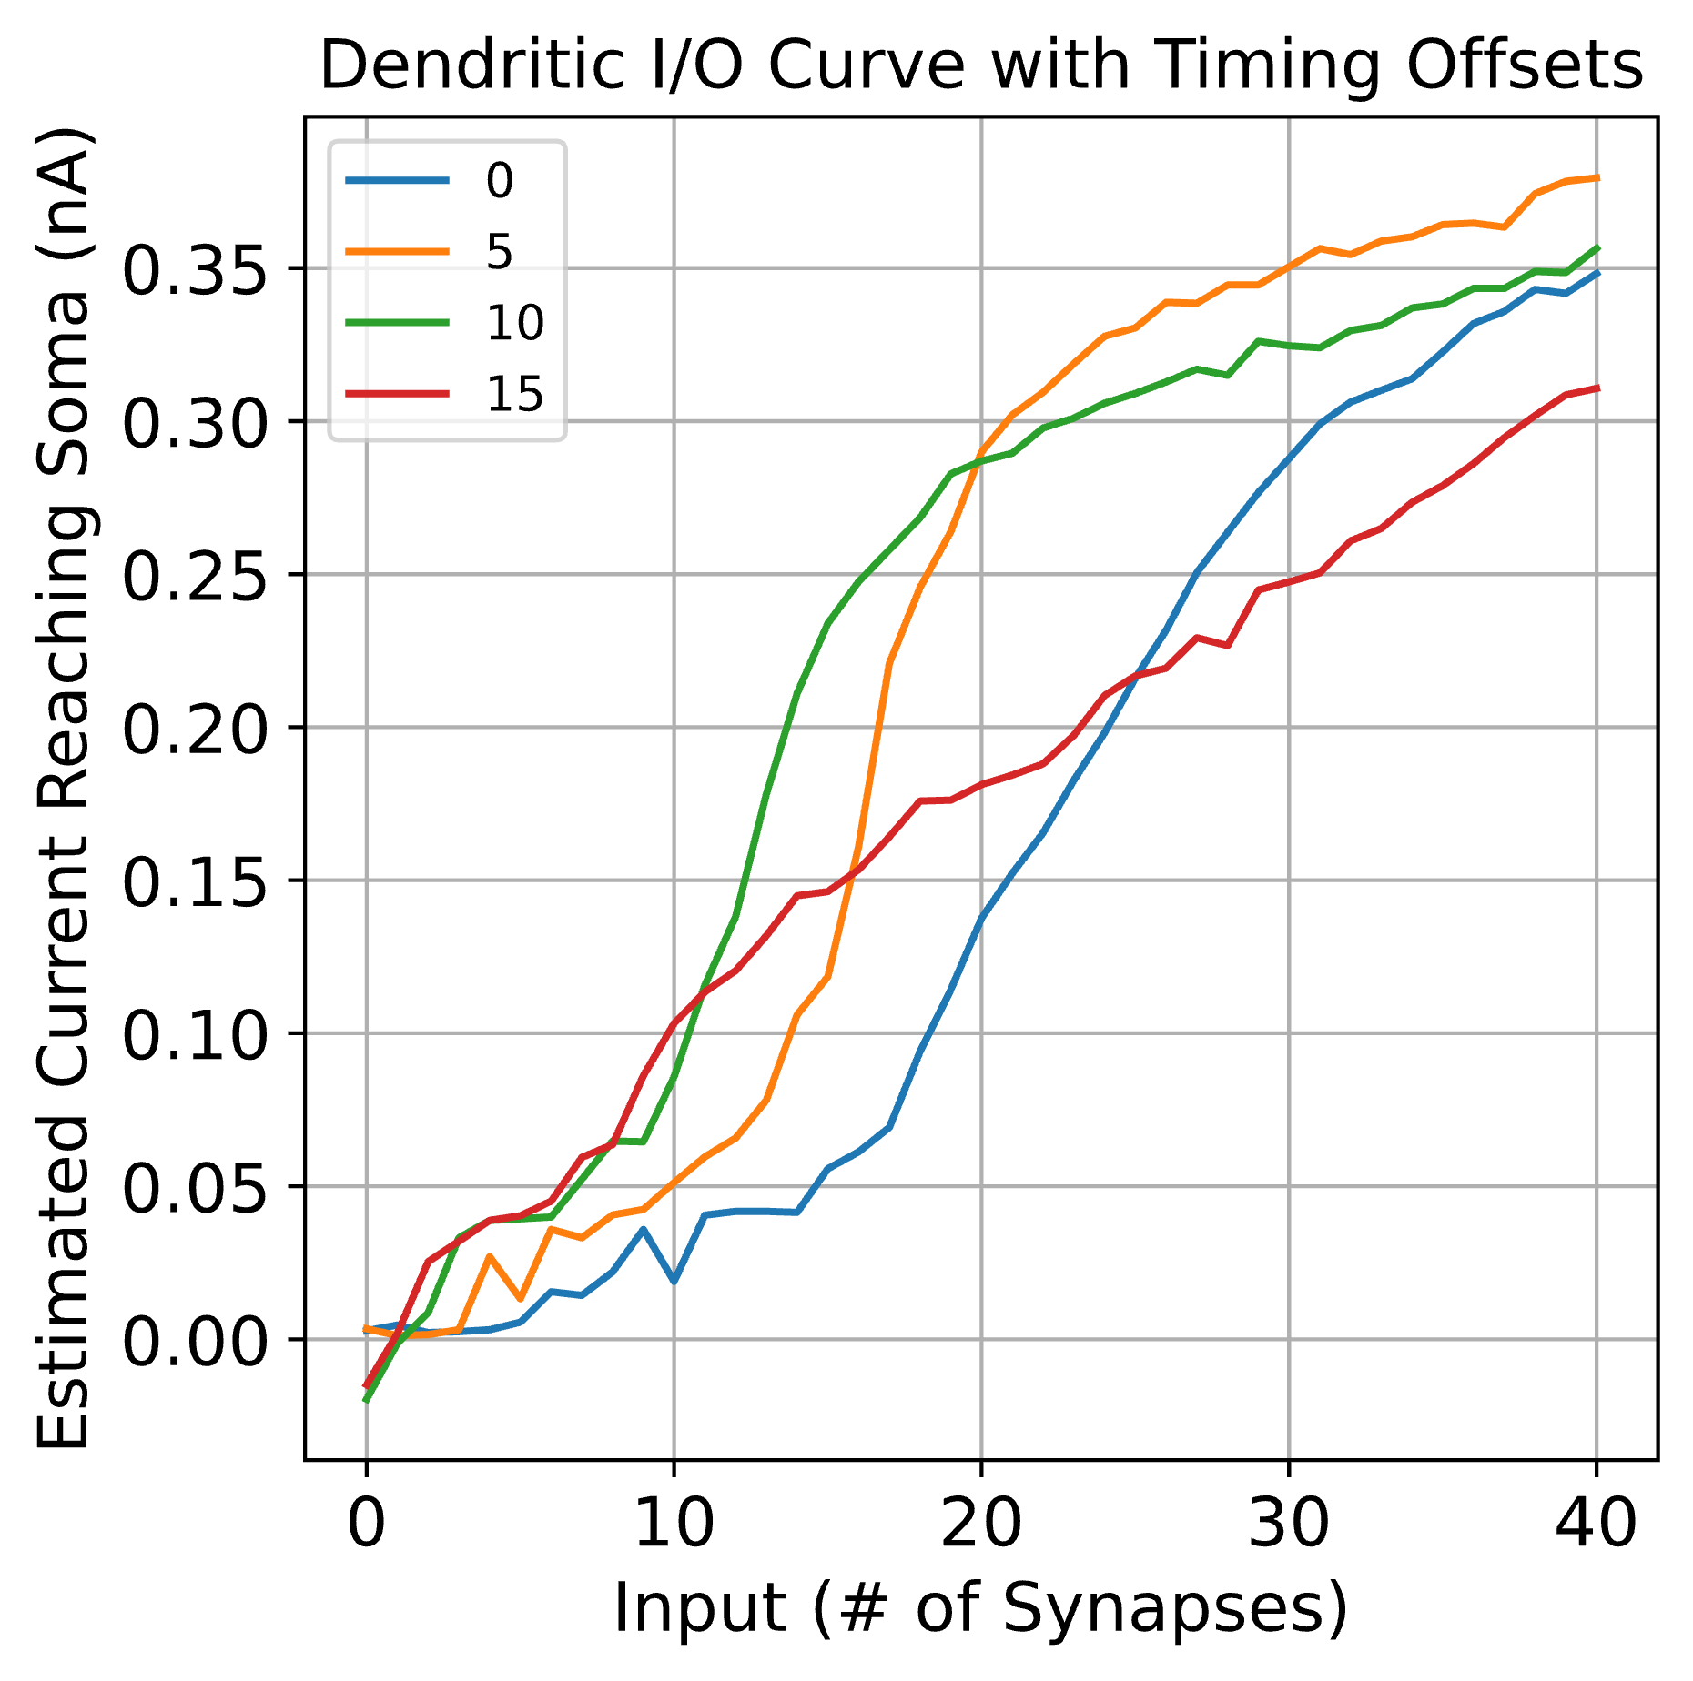
Compiled I/O Curve

Slide 24
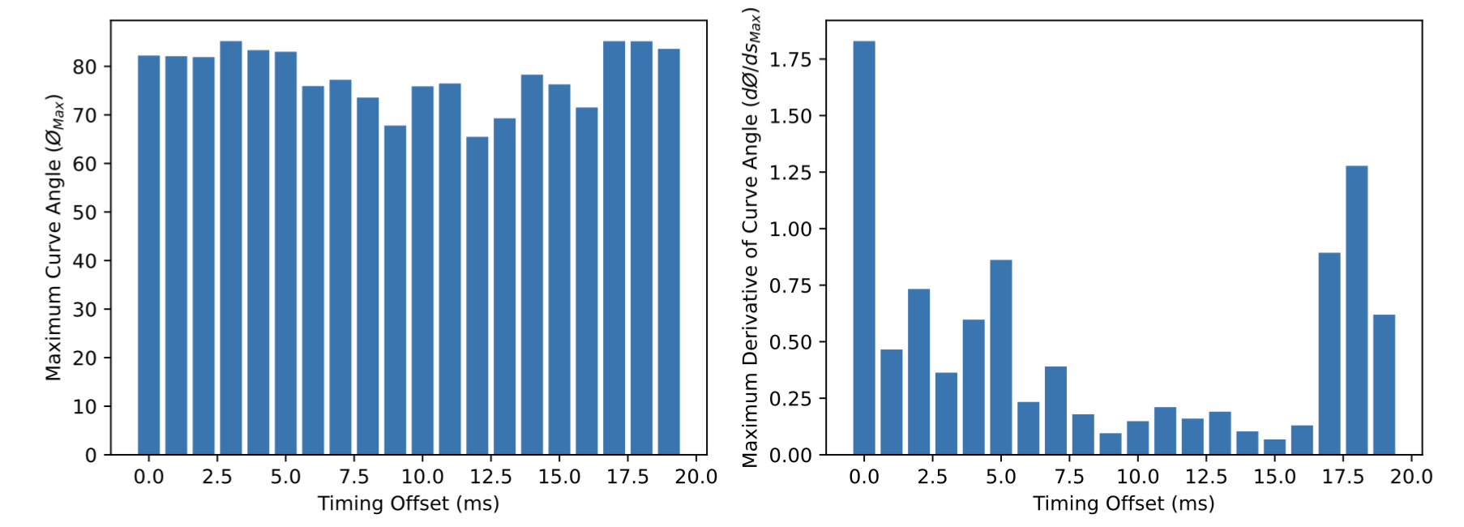
Nonlinearity Scores

